Slide 1
Applications of Opensource in Big Data Management with Examples
Michael Fudge
Professor of Practice
Syracuse University
CASL Workshop, December 2022
Notes:
This course is very much a tour of the modern database landscape. Before we begin that tour, its helpful to understand how we got here and why.

Slide 2
About Me
Professor of Practice in the School of Information Studies at Syracuse University
Career Background
Data warehousing / Business intelligence
IT Systems Management
Software / Web / Mobile application development
Academic Areas of Interest
Academic Computing Infrastructure (Kubernetes, Jupyterhub)
Learning Analytics / AI assisted learning
Internet of Things

Slide 3
About this talk: Two Parts
Presentation
Pre-Recorded Lecture
Overview of Open-Source tools for Big Data management.
Conceptual and Foundational
Gain an understanding of the landscape.
Demonstrations of the big data lab environment with examples of how to use it.
In-depth and Experiential
Try out Spark, Spark SQL, Object storage, MongoDb, Cassandra, and Neo4j.
https://github.com/mafudge/cas-library-bigdata-workshop-2022

Slide 4
Sections of This Talk
The Long Journey to Defining Big Data
Big Data Tools for Storage and Compute
Hadoop: HDFS / MapReduce
Spark: PySpark and SparkSQL
Common NoSQL Big Data Databases
Document / MongoDb
Big Table / Wide Column / Cassandra
Graph / Neo4j

Slide 5

The Importance of Data
Notes:
To begin our journey, let’s re-emphasize why data is so important in the first place.

Slide 6
Questions?
Why are US Social networking companies like Facebook, Google, and Twitter free services?
Why do retail companies like Target, Starbucks, and Verizon have customer rewards programs?
What makes rideshare services like Uber or Lyft more efficient than taxis?
DATA
Notes:
In the case of Facebook, Google and twitter, we offer personal information about ourselves including what we are doing in our lives in exchange for use of their services. In turn these companies use this data to better market to us. This is similar with rewards programs from companies like Target, Starbucks and Verison, only they use our spending habits to market product and services. Data about customers using the ride share services is what makes them more efficient that taxi companies.

Slide 7
Two Kinds of Data
Reference-Oriented Data
Process-Oriented Data
Business Entities; Data that references a person, place or thing
Any row is updatable over time, Full CRUD
Limited growth, can be frequent changes.
Rows referenced by a natural or business key
Data Relationships; Data corresponding to an event or process
Immutable – rows do not update, CR no UD
Rapid growth
Rows have no natural key; have a timestamp or composite key

Slide 8
The Prevalence of Data
Data are everywhere!
There has been an explosion of data over the past few years
The majority is process-oriented data. Based on sensors or events.
There are new varieties of data.
Business data → user generated data → device generated data
And there are different mediums than before.
Structured → semi-structured → unstructured text → multimedia

Slide 9
Example of how the volume of Organizational data has grown over time.
Business Data
Web/Clickstream
Social Networks
Mobile
Sensor/IoT
Data Volume
1980
1990
1995
2000
2005
2010
2015
2020
Years

Slide 10
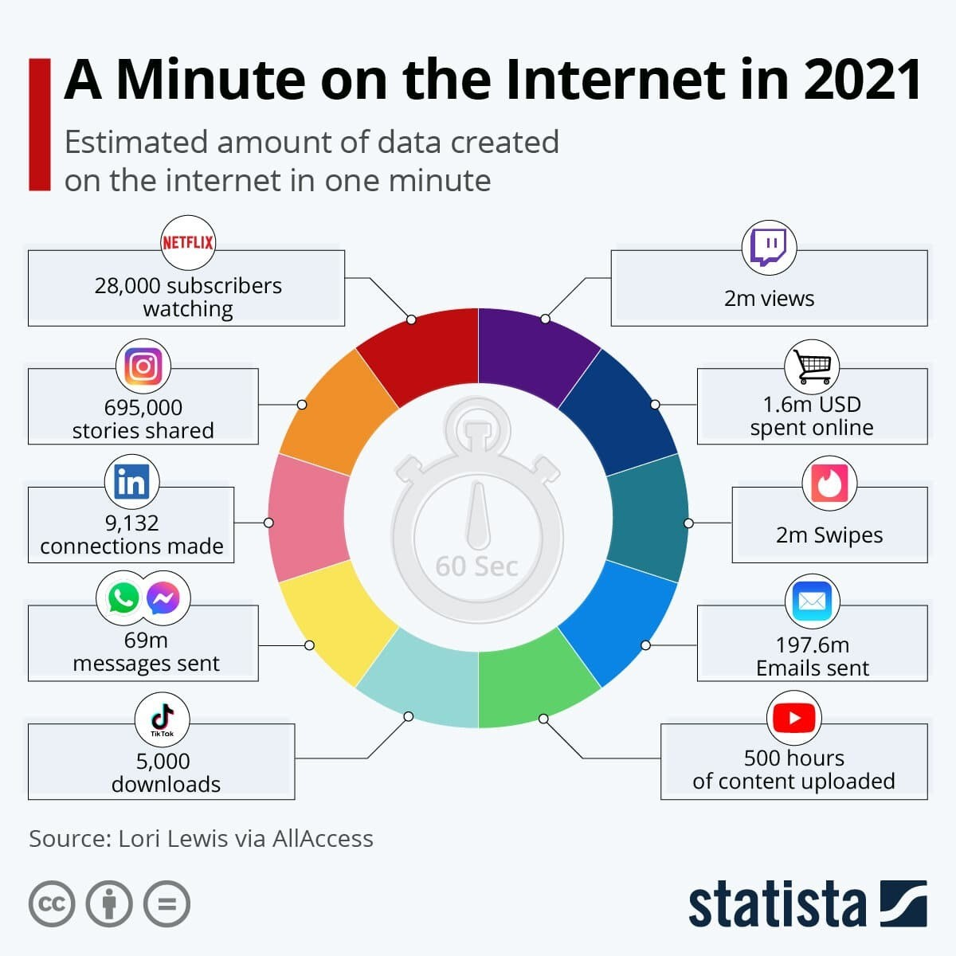

Slide 11












How many devices are connected to the Internet?
2020 50B
Billions of Devices
2019 42.1B
50
2017 28.4B
2016 22.9B
2018 34.8B
40
2014 14.2B
2015 18.2B
30
2009 IoT Inception
20
2012 8.7B
1992 1M
2003 0.5B
10
2013 11.2B
0
1988
1992
1996
2000
2004
2008
2012
2016
2020
Notes:
The number of devices connected to the internet has already surpassed the global population. This trend will continue until there are an estimated 50 Billion devices… or approximately 6 devices per every single person on the planet!

Slide 12
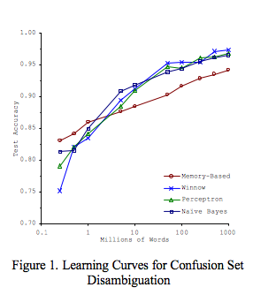
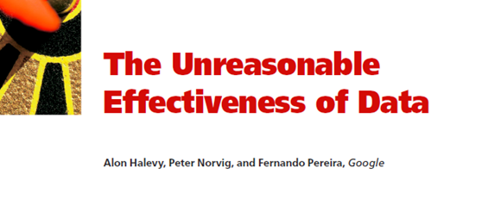
More Data… Better Machine Learning!
Halevy, Norvig & Pereira, 2009: “Data set size matters
more than algorithms”
Big Data is important. Size does matter!
Data size matters more than the algorithm!
Banko & Brill, 2001: “Algorithms Predict Better with Larger Data Sets”

Slide 13
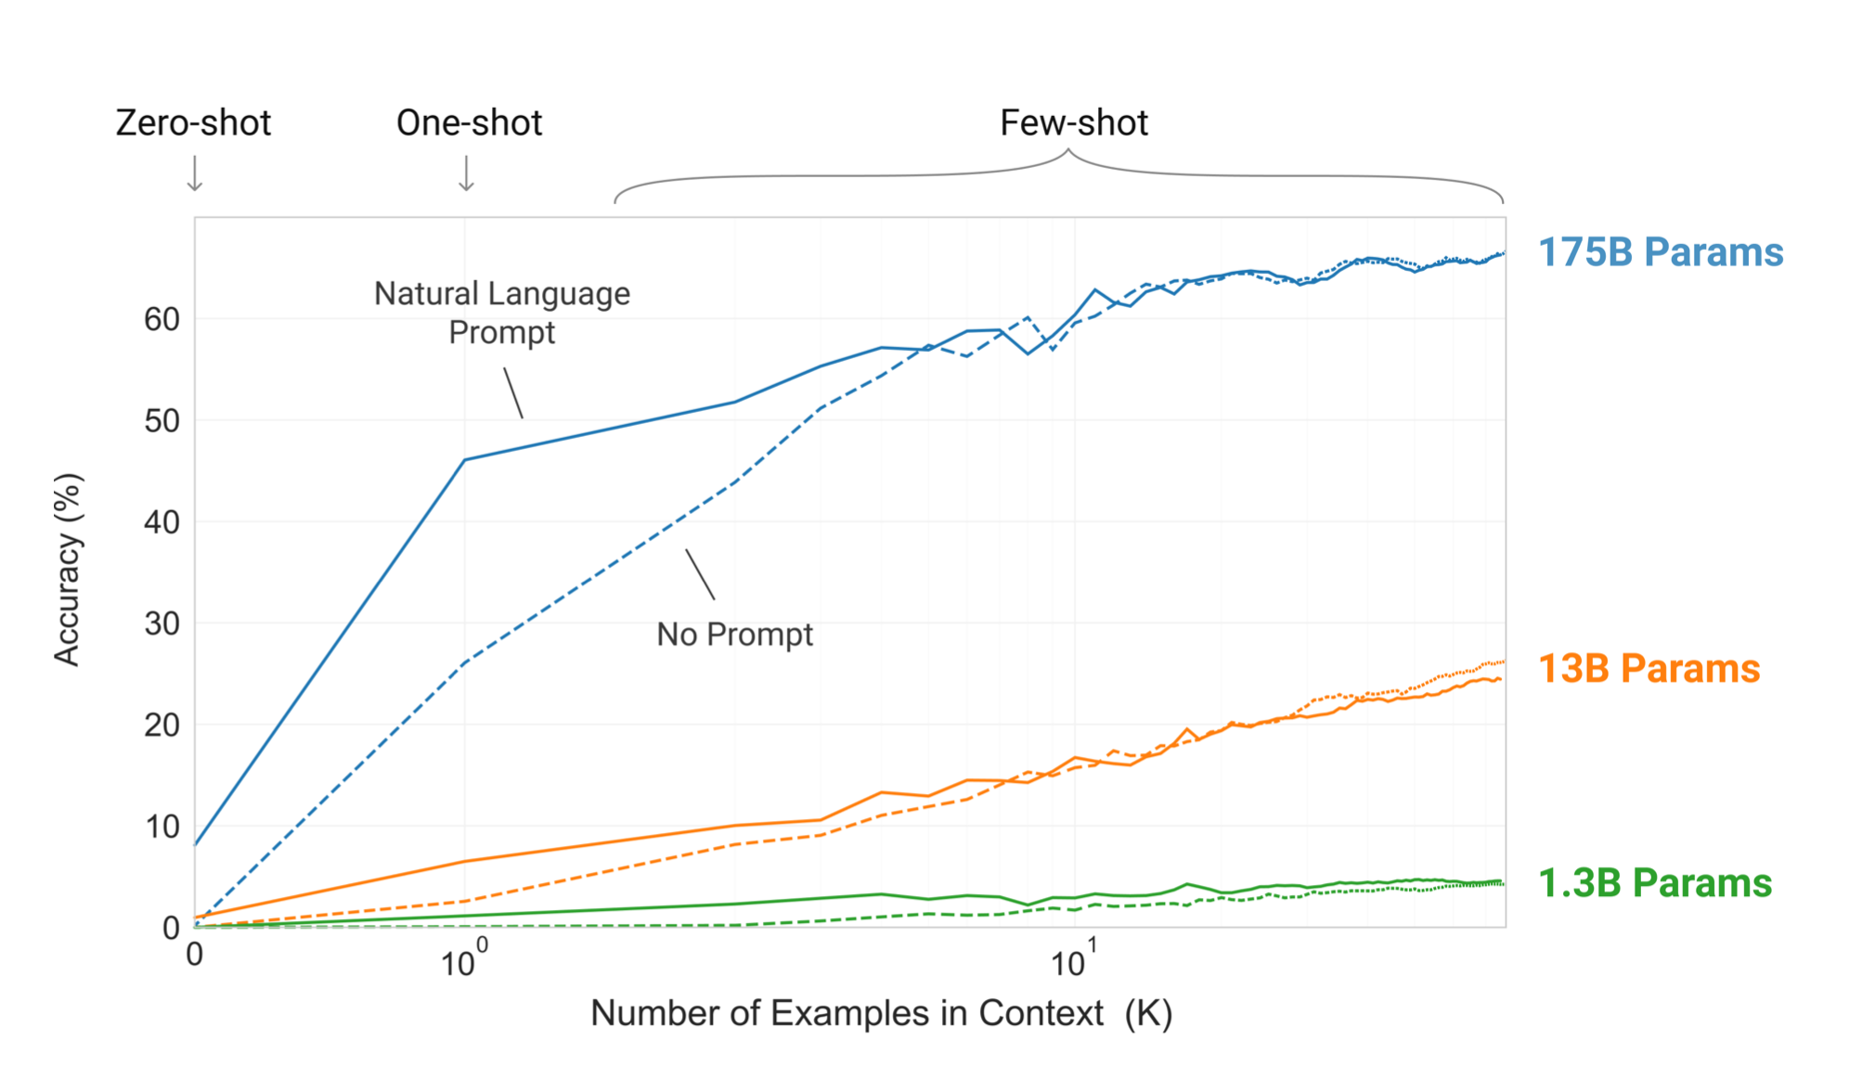
GPT-3 – A Text Completion Model
Zero Shot Prompt: “List fruits”
One Shot Prompt: “List Fruits For example: Apple”
Few Shot Prompt: List Fruits For example: Apple Banana Orange”
https://medium.com/analytics-vidhya/openai-gpt-3-language-models-are-few-shot-learners-82531b3d3122
Notes:
Zero shot, one shot, few shot is the amount of training to the task, like completing an email for you or predicting a sequence of steps.
Zero shot = list of nba teams
One shot = list of nba teams: bulls
Few shot = list of nba teams: bulls, lakers, pistons
1.3B is GPT
13 B is GPT2
175 B is GPT3
https://medium.com/analytics-vidhya/openai-gpt-3-language-models-are-few-shot-learners-82531b3d3122

Slide 14
The extraction of value from data is not trivial
The more data, the greater the chance for value within
But the more data the more effort is required to extract that value!

Slide 15
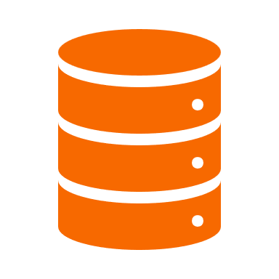
Criticisms of the Relational Database Model
Notes:
Let’s explore how and why the relational model is not well suited for big data and how this led to alternative database systems with different storage models

Slide 16
What Makes the RDBMS Great?
Easy to understand tabular structure,
Table meta-data and data integrity constraints help to ensure we don’t write “bad data”
Data in tables are normalized to minimize redundancy and improve data consistency
Wide adoption and an abundance of tools
Support for SQL (Structured Query Language), which is easy to learn
ACID: Writes are atomic, consistent, isolated, and durable.
The de-facto standard—mature and proven

Slide 17

PROBLEM:
When all you have is a hammer (RDBMS), every data problem looks like a nail.

Slide 18
One Size Does Not Fit All !
No one database management system is best suited for all of the complexity and variety of data found today.
Therefore, different systems exist; to manage data that vary in:
Structure
Size
Rate of change
We’ve learned the hard way that not all data problems are nails, and there is more than just the hammer.
Most relational database vendors are keen to this and now offer hybrid options, that go beyond relational, but still….

Slide 19
Three Main Criticisms of the RDBMS
Rigid schema does not support storage of variety of data for purposes beyond OLTP.
Systems do not scale. Consistency of RDBMS makes them difficult to distribute
Data is stored at rest; RDBMS does not handle data in motion.

Slide 20

Scalability
Notes:
The exposition of big data means we need our systems to scale. But what exactly does this mean?

Slide 21
RDBMS does not scale easily
Out of the box, Increases in data volumes and transactions per second lead to decreases in performance.
Companies throw hardware at the problem, buying datacenter in a box solutions like Oracle RAC, SQL Server MPP, or Vertica. This is expensive!
Companies hire specialists to set up clustering and improve performance through indexing, caching, and partitions. Requires money and expertise!
NewSQL: “We can scale that for you, but you will need to use the cloud!” - Google Cloud Spanner, Amazon Aurora, or MemSQL.

Slide 22



Scaling: Up Versus Out
Vertical Scaling “Up”
Horizontal Scaling “Out”
Add more resources to an existing system running the service
Easier, but limited scale
Single point of failure
Any system can be scaled up
Run the service over multiple systems, and orchestrate communication between them
Harder, but can achieve unlimited scale
Overhead resources needed to manage nodes
System must be designed to do it
Notes:
Amazon EC2

Slide 23
Over-Simplified Example: Some Website Hosted at AWS
Scale it up
Scale it out
It is hosted on amazon EC2.
Upgrade the compute instance from
t2.micro 1 CPU 1 GB to
t2.xlarge 8CPU 32 GB
Just pay more and you are done.
When you update the website content, you do it once.
Setup AWS Elastic Load balancer in front of your site.
Duplicate your t2.micro instance 7 times (you now have 8 copies)
Configure ELB to route traffic to one of your 1 of 8 instances of your website.
When you update the website, you need do it 8 times

Slide 24

CAP Theorem
When you scale out, you must concede data consistency or availability
Notes:
So our goal is to scale out. What does that mean for our data? How do we scale systems horizontally that store data?

Slide 25
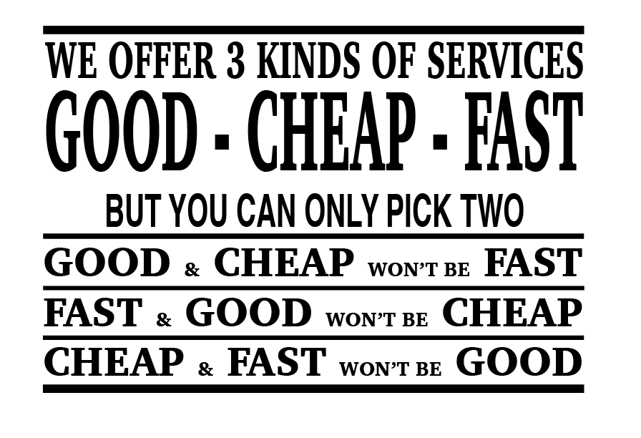

Slide 26
The CAP Theorem of Distributed Data Stores
Eric Brewer¹: You can only have two of the following three guarantees:
Data consistency: all nodes see the same data at the same time
Data availability: assurances that every request can be processed
Partition tolerance: network failures are tolerated, the system continues to operate
Relational DBMS are designed to be consistent and available and therefore cannot be partition tolerant.
1. Brewer, E. A. Towards Robust Distributed Systems. Portland, Oregon, July 2000. CAP theorem.

Slide 27
Fundamental Principle of Distributed Data
IF you scale data out (so that data are distributed among multiple systems)
THEN you must choose:
To have data consistency at the expense of data availability
OR
To have data availability at the expense of data consistency

Slide 28
Why Can’t We Have All 3?
Node 1
Node 2
Suppose we lose partition tolerance between nodes. Then:
We must ignore any updates the nodes receive, or we sacrifice consistency,
Or we must deny changes until it becomes available again.
If we choose to guarantee availability of requests, despite the failure:
We gain partition tolerance (the system still works) but lose consistency (nodes will get out of sync).
If we choose to guarantee consistency of data, despite the failure:
We gain partition tolerance (again, system works) but lose availability (data on nodes cannot be changed, until the failure is resolved).

Slide 29
Database Systems and the CAP
Consistency
Partition
tolerance
Availability
Non-Distributed
Single-master
What is guaranteed?
CA
CP
X
AP
Eventual consistency

Slide 30
Single Master CP Systems
A leader node is responsible for orchestration of writes. The leader stores no data
If Leader goes down, we lose availability as we can no longer write.
Even if the leader does not go down there are slight gaps in availability as the leader must propagate changes to other nodes.
leader
A,B
A,C
C,B

Slide 31
Eventual Consistency AP Systems
B,C
There is no leader node or single master. We read and write to any node.
Any node can fail, and we can write still but our reads will be inconsistent.
Even when we don’t fail not all nodes will be consistent immediately, as changes must propagate to other nodes
A,B
C,A
Notes:
You are

Slide 32
All Types of CAP Databases
CA: RDBMSs like Oracle, MySQL, and PostgreSQL:
Focus on consistency and availability (ACID principles), sacrificing partition tolerance (and thus they don’t scale well horizontally)
Use cases: business data, when you don’t need to scale out
CP: Single-master systems like MongoDB, HBase, Redis, and HDFS:
Provide consistency at scale, but data availability runs through a single node
Use cases: read-heavy; caching, document storage, product catalogs
AP: Eventual consistency systems like CouchDB, Cassandra, Redis and Dynamo:
Provide availability at scale but do not guarantee consistency
Use cases: write heavy, isolated activities: shopping carts, orders, social media

Slide 33
ACID vs BASE
ACID Databases (CP)
BASE Databases (AP)
Atomic: Everything in a transaction succeeds, or the entire transaction is rolled back.
Consistent: A transaction cannot leave the database in an inconsistent state.
Isolated: Transactions cannot interfere with each other.
Durable: Completed transactions persist, even when servers restart and so on.
Basic availability: Data can be read and written to any node.
Soft-state: Nodes may change over time, even without direct updates.
Eventual consistency: At some point all nodes will have the same data.

Slide 34
So, all Distributed Databases Are a Choice Between Availability and Consistency?
Well….

Slide 35
NewSQL Systems
Service
Discovery
Leader 1
Leader 3
Circumvent the CAP theorem by combining AP and CP systems
Leaders are AP and always available
Data storage is CP and thus always consistent.
Multi-layering ensures available and consistent data at scale.
Leader 2
A,B
A,C
C,B
Database
Notes:
You are

Slide 36
NewSQL
Typically, The Relational Model at Scale;
ACID Compliant
Horizontal Scalability
Why Relational? Its flexible and proven
Complex system architecture thus cloud hosted or Kubernetes.
Database as a service in the cloud:
Google cloud spanner, Amazon Aurora, Azure CosmosDb, MemSQL
Open source:
CockroachDB, YugabyteDB

Slide 37

NoSQL
The Rise of NoSQL
Notes:
With a handle on scalability, let’s address the other issue of relational – the relational model itself!

Slide 38
NoSQL
NoSQL stands for “not only SQL.”
It generally refers to a wide range of database systems that address the scalability and other challenges of the relational database model.
The entire point of NoSQL is that your need is not met by the relational model (really has nothing to do with SQL itself).
It is not an anti-SQL or anti-relational database movement, although can be perceived that way.
Not all problems are nails. Not all solutions are hammers!
NoSQL databases use purpose built models whereas relational are more general purpose.

Slide 39

NoSQL Data Models
Of NoSQL Databases

Slide 40
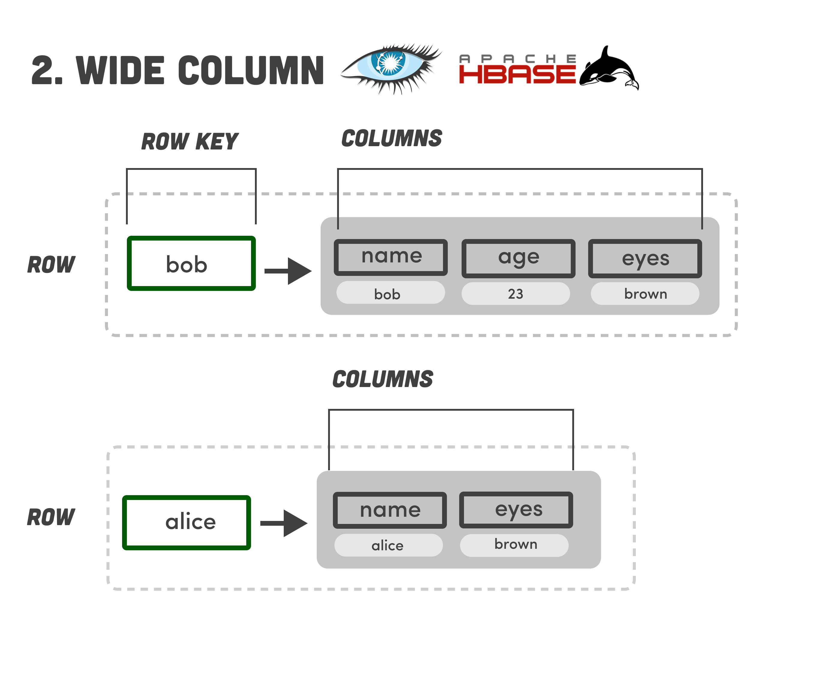
Wide-Column
Open Source:
Cassandra, HBase
Data stored under a row key.
Value consists of columns of data in one big table.
Every row does not need the same set of columns. Flexible schema.
Common columns can be grouped and stored together.
Not full CRUD, more CR.
Designed to be BASE; Fast, guaranteed writes.
SQL-Like query language

Slide 41
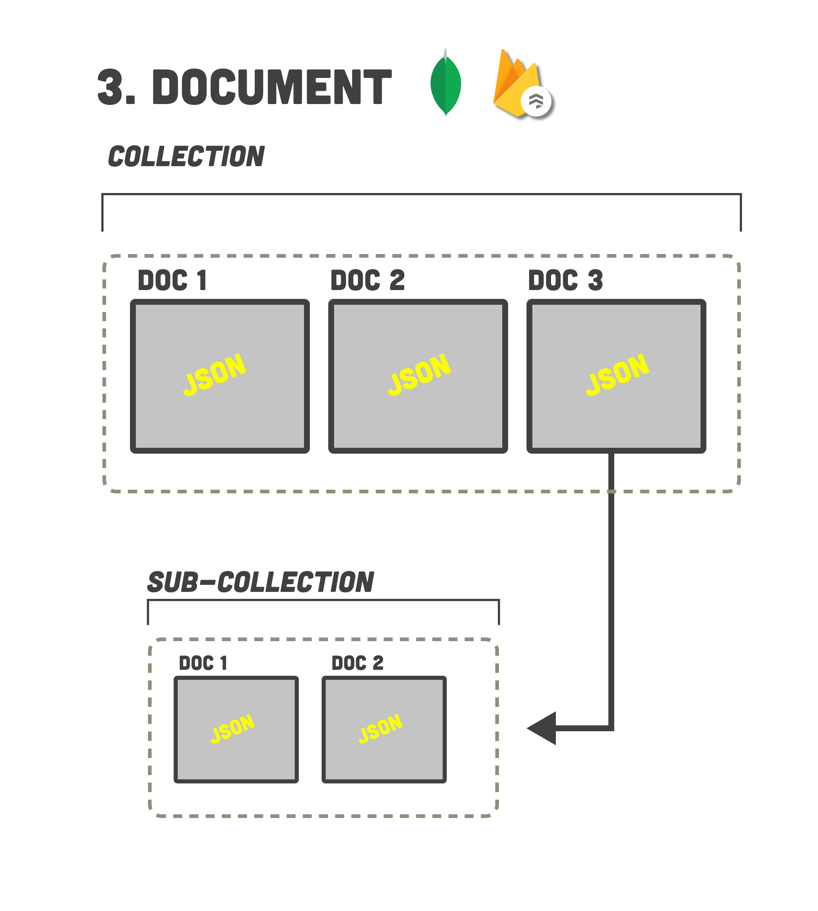
Document
Open Source:
MongoDb, CouchDb
Keyed Data stored as documents in collections.
Data is usually semi-structured, JSON format, consisting of key-value pairs.
Documents in collections can have pointers to documents in other collections.
Full CRUD.
Systems can be ACID or BASE
Custom Query Language

Slide 42
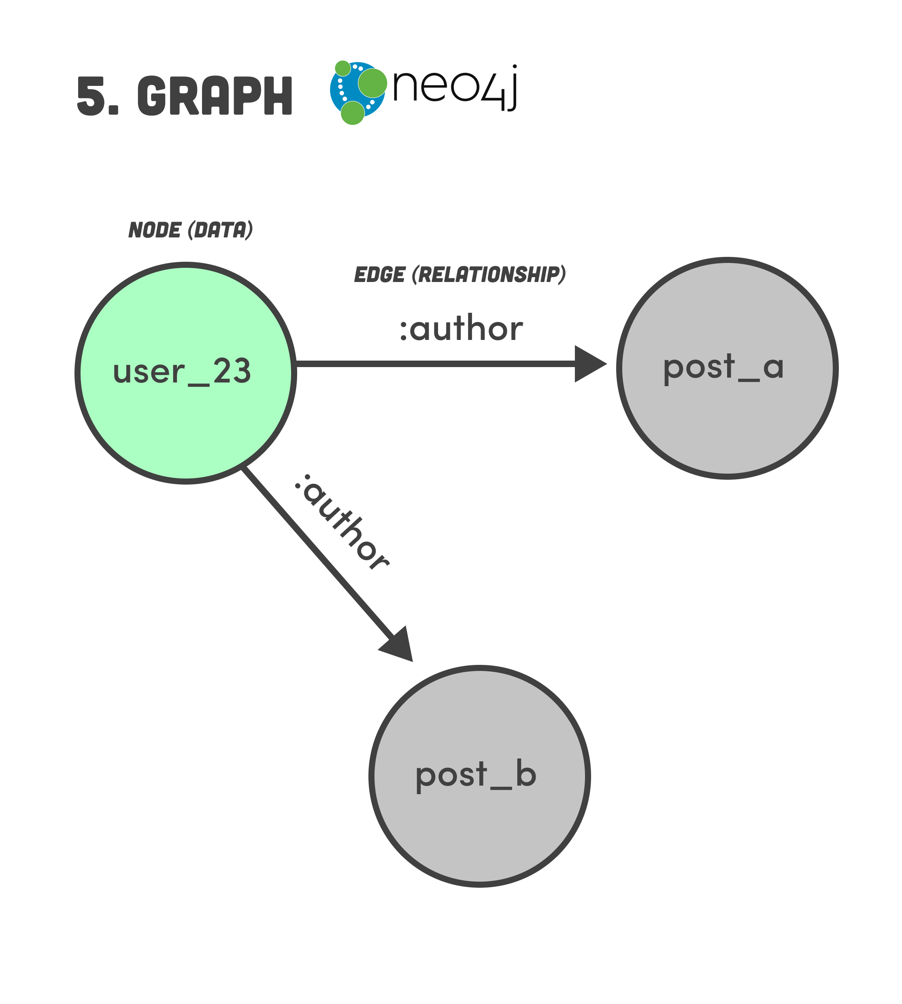

Graph
Open Source:
MongoDb, CouchDb
Data model consists of node and edges.
Structured and unstructured data may be stored in both the node and edge.
Idea for data consisting of complex relationships.
Supports full CRUD.
Systems can be ACID or BASE
Custom Query Language, very unlike SQL.

Slide 43
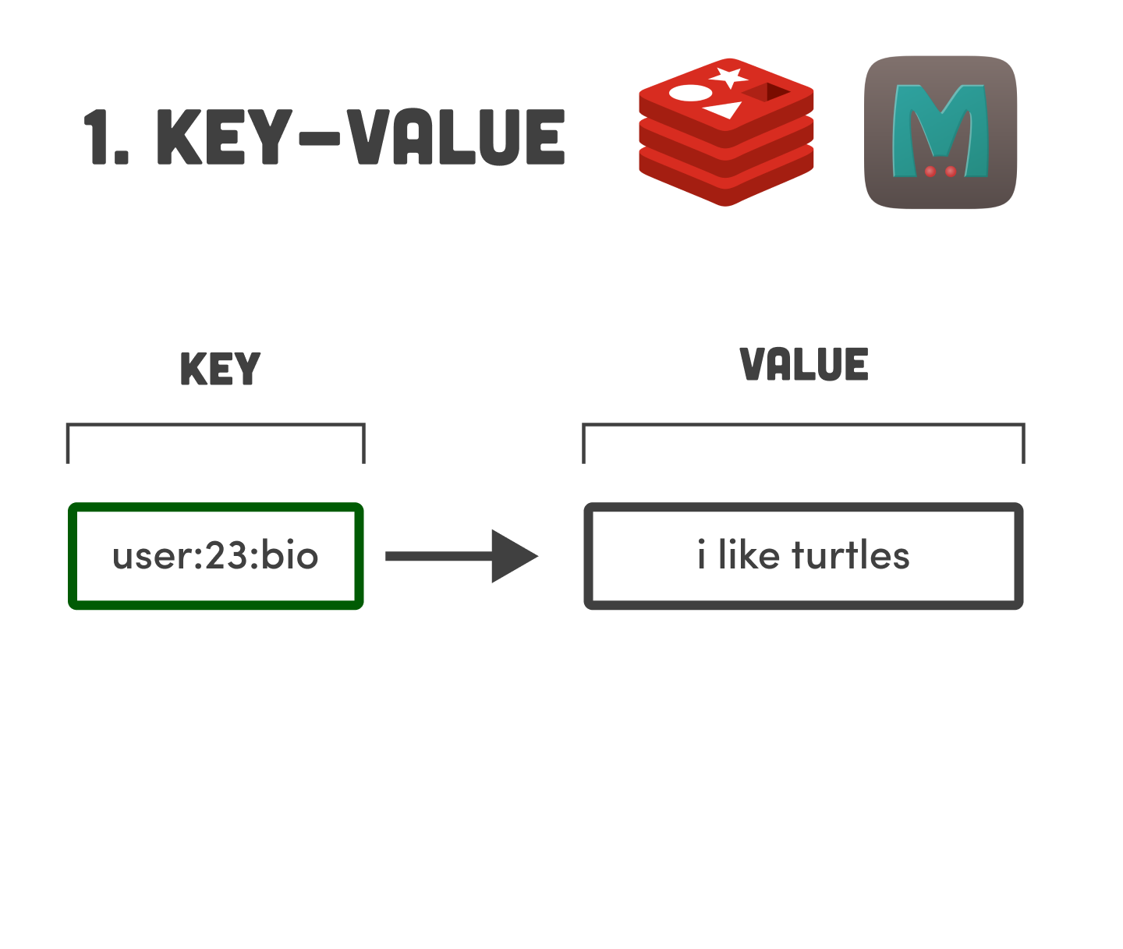
Key-Value
Open Source:
Redis, Memcached
Data stored under a key.
Value can be anything.
Keys can be name spaced.
Very simple data model.
Very fast and efficient.
Supports full CRUD.
Commonly used to store data you need to retrieve quickly, as if it were in memory.
Simple Query Language
ACID or BASE

Slide 44
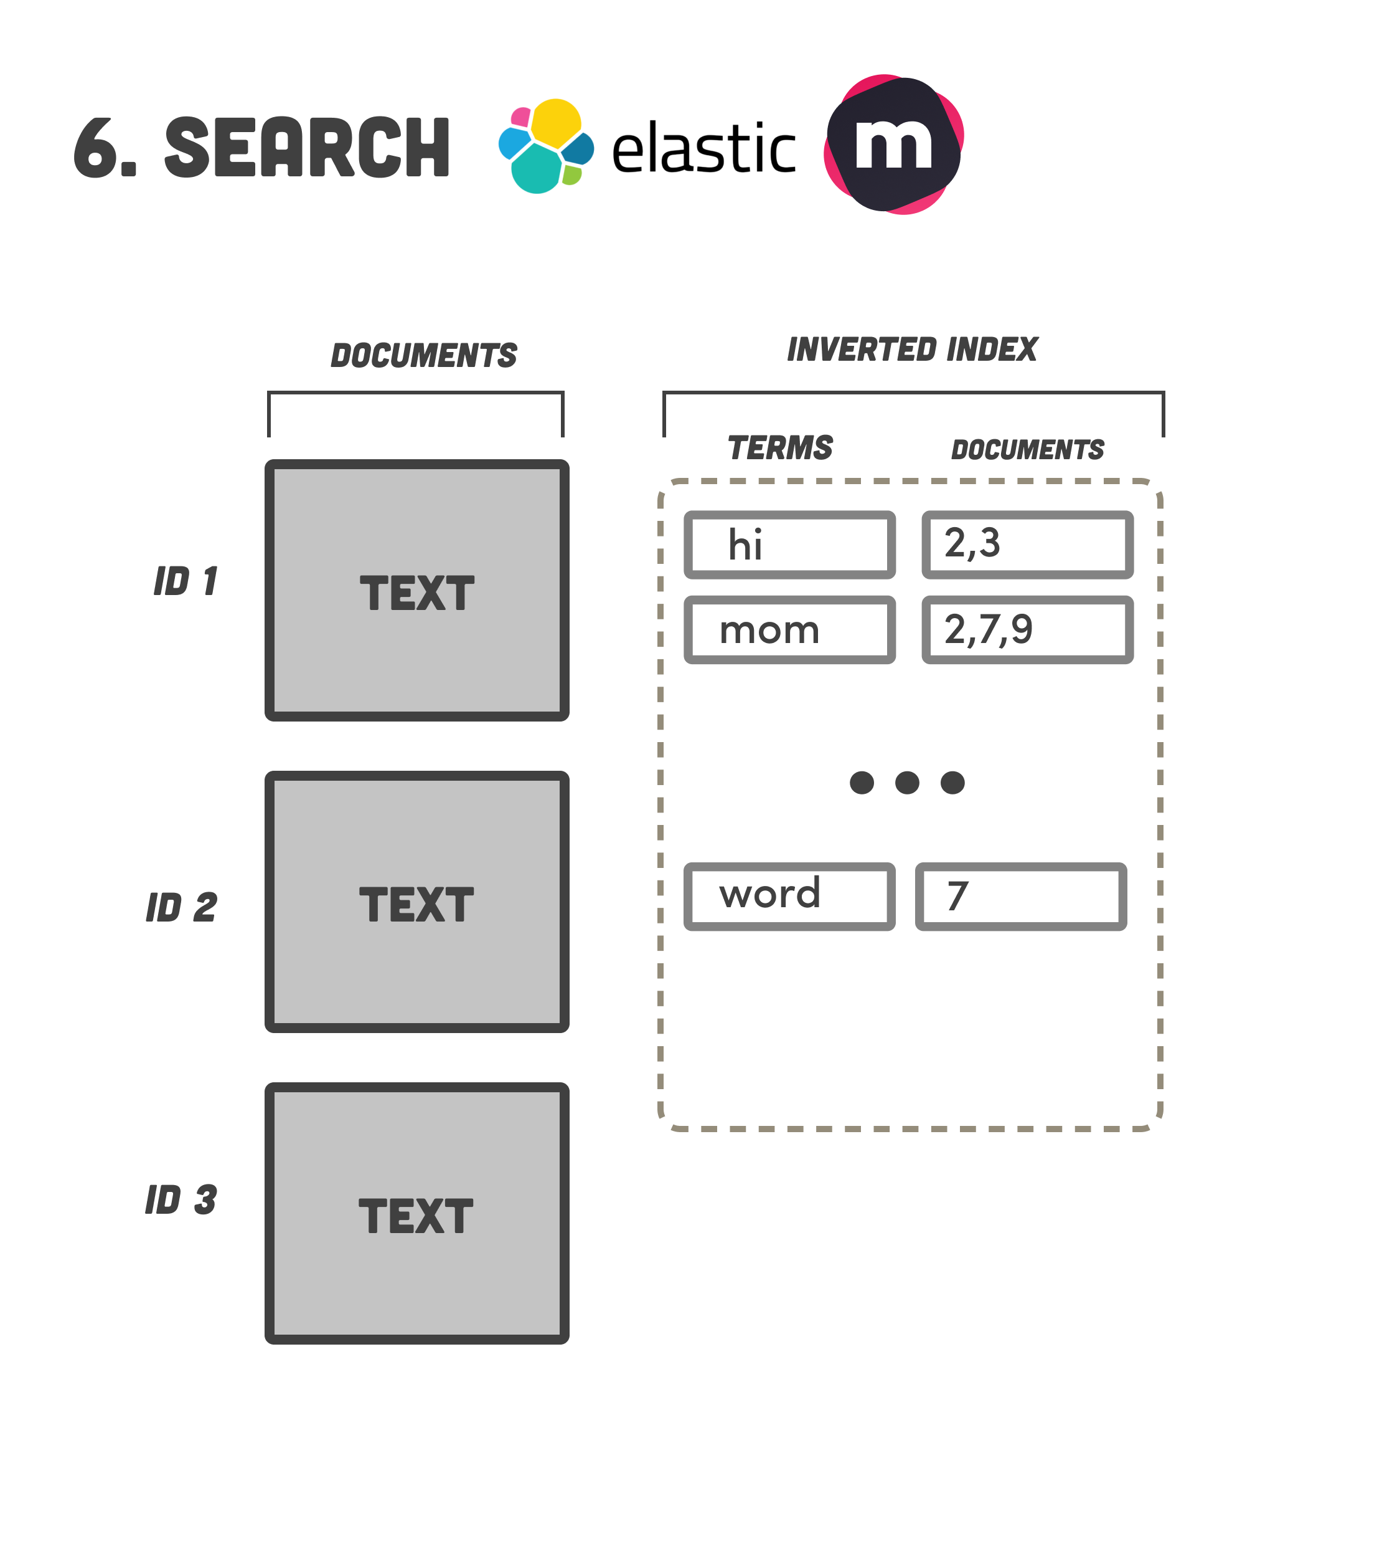
Search Engine
Open Source:
Elasticsearch, Solr
Documents can be structured, semi-structured, or unstructured.
Indexes are created over the documents, and one can search for any content within the document.
Search can find any data within the document; semi-structured data can be keyed.
Not full CRUD, more CR.
Systems are typically BASE
Custom Query Language, non-SQL like.

Slide 45

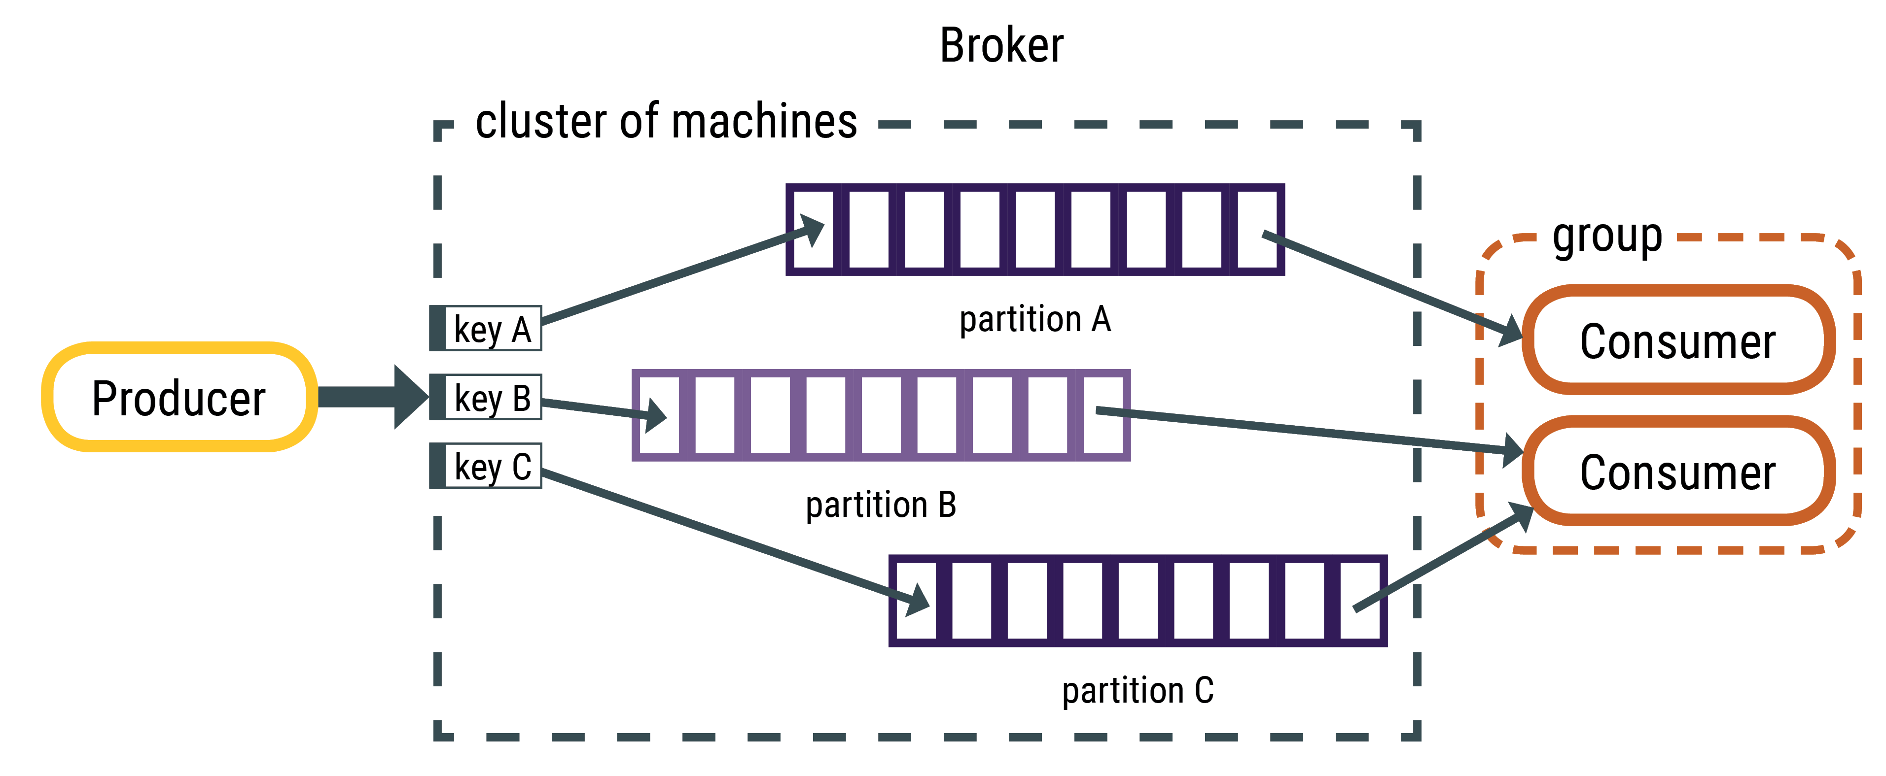
Streaming
Open Source:
Kafka
Supports structured, semi-structured, or unstructured data.
Data in motion, not data at rest.
Producers sends data, consumers receive it.
Data is sent to a topic where it awaits consumption by consumers.
Systems are typically BASE + ACID
API’s for publishing / subscribing to topics.
Custom Query Language

Slide 46
Multi Model
PostgreSQL is a relational database but has adopted many of the features found in NoSQL databases.
In memory tables for basic CRUD operations (Like Key-Value)
Document database for no-schema with JSON support
Graph support through Apache AGE
In-Memory support for Key-Value
Connectors to query unstructured data.
Most RDBMS are now Multi-Model, including support for other models like Graph, Document, and Key-Value.
This does not imply these systems will scale horizontally easily.
Multi-Model databases are evolving in their features, performance and usability.
Oracle, PostgreSQL, and Microsoft SQL Server are Multi-Model

Slide 47
The NoSQL Guide
Database Model | Best In Class ** | AWS | Azure | GCP
Relational | Oracle (rank:1) | Aurora | Azure SQL | Cloud SQL
Document | MongoDb (rank:5) | DocumentDB | CosmosDB (multi-model) | Firestore
Key-Value | Redis (rank:6) | DynamoDB | CosmosDB (multi-model) | Datastore
Wide Column | Cassandra (rank:12) | Keyspaces (Cassandra) | CosmosDB (multi-model) | Bigtable
Graph | Neo4j (rank:20) | Neptune | CosmosDB (multi-model) | Neo4j
Search | Elasticsearch (rank:8) | Elasticsearch | Elastic Stack | Elasticsearch
Object | Minio (rank:none) | S3 | Blob | Cloud Storage
Streaming | Kafka (rank: none) | Kinesis | Event Hubs | Confluent cloud
** https://db-engines.com/en/ranking

Slide 48

Big Data Defined
Notes:
Let’s conclude with a re-definition of big data

Slide 49
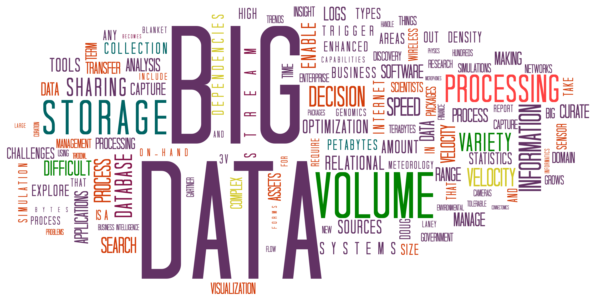
Finally, Defining Big Data
Any data set too large
to be processed or stored by a single system and therefore, must be scaled horizontally.

Slide 50
3 Factors of Big Data
1. CAP Theorem
3. Distributed Data Processing
2. Data Volume and Velocity
Notes:
Let’s explore each further

Slide 51
1. CAP Theorem
By definition, Big Data are distributed over more than one system.
Therefore, we require partition tolerance so will have three choices:
Concede consistency to guarantee availability?
Concede availability to guarantee consistency?
Use NewSQL layering of AP service discovery with a CP system?

Slide 52
2. Data Volume and Velocity
Why are Big Data distributed?
There are two reasons:
Data Volume The quantity of data is too large to : Diagram data set too large to fit on a single system
Data Velocity. Data is written at a rate causing a single system to be I/O bound.

Slide 53
3. Distributed Data Processing
Big Data are distributed; thus, data processing needs to be reconsidered.
Cluster computing allows the processing to scale with the data.
This requires different thinking from traditional data processing.
When processing distributed data, we need to consider our actions

Slide 54
A Bottleneck Processing Distributed Data
Data Storage
“Count NY orders”
Lifting data off the data storage results in 35 B rows being processed in a single node
This ends up being a choke point, negating the benefits of distributed data storage.
10 B rows
Processing
Combine Data Sets (35 B rows)
Filter for “NY” (35K rows)
Count (1 row)
15 B rows
10 B rows

Slide 55
Distributed Data Processing Same Example
Data Storage
Part of the processing is distributed to the data storage
Data is filtered where its stored and now only thousands of rows are transferred over the network versus billions.
1. Filter for “NY”
7 K rows
Processing
20 K rows
Combine (35K rows)
Count (1 row)
1. Filter for “NY”
1. Filter for “NY”
8 K rows
Notes:
This is a very high level example how big data frameworks like Hadoop and spark operate

Slide 56
Is Your Data Big Enough?
Don’t scale horizontally unless you must.
Big Data systems are complex and costly to administer.
How will you know its time? You can no longer scale up to improve performance.
Leverage the cloud when possible, to avoid upfront hardware and administrative costs.

Slide 57

Hadoop
The What, Why and How

Slide 58
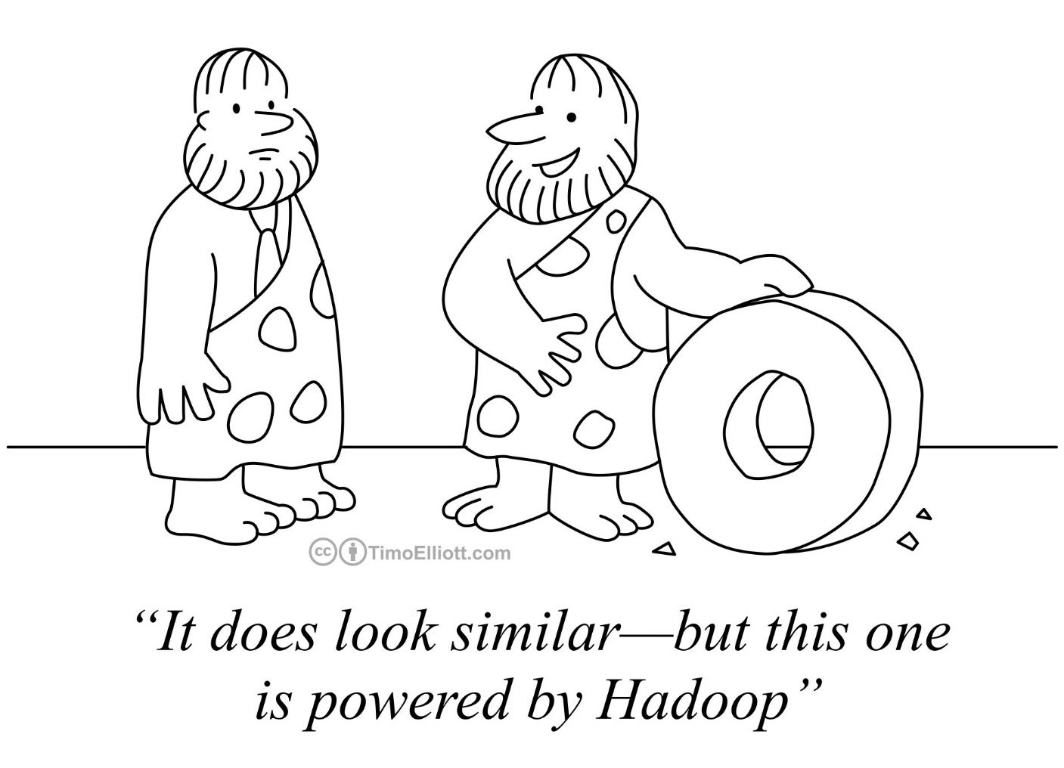
What is Hadoop?
A System for Storing, Processing and Managing Data
Just Like a DBMS only for “big data”
What does that mean? Scales Out by design, both the data and compute to process it.

Slide 59
Hadoop Origins
The origins of Hadoop can be traced back to the internet companies of the 2000’s
Google, Facebook and Yahoo!
These companies had a similar problem.
The solution was to split the data and distribute chunks of it to be processed in parallel.
Time to process one day’s worth of data
24 hours!

Slide 60
They did the math…
Relational DBMS
Hadoop
60 Minutes to read 500GB of data off the disk on 1 node (assuming 1Gbps)
14 seconds to read the same 500GB with 40 nodes x 8 disks per node.
60 min
14 sec
1.56GB
1.56GB
…
500GB
1.56GB
1 Node
40 Nodes 8 Disks = 320 Independent reads

Slide 61
How does Hadoop Work?
Let’s Explore the concepts of Hadoop (Data Lake, Schema On Read)

Slide 62
The Hadoop Philosophy is Simple
Capture data as is and store it do not create a schema for it.
Do not transform the data before storing it. We don’t know what we plan to do with it yet!
Keep everything. You never know what you will need when!
When you retrieve the data, we then apply a schema and transform it to suit our needs. (Schema on Read)
This is very different from relational modeling where we are not able to store data without creating a table first.

Slide 63


The Data Lake
Contrast this to the data mart which is filtered and packaged for consumption!
An industry term for vast amounts of data stored in its native format.
Hadoop data are stored in a data lake.
Like real lakes, data lakes are unprocessed and vast.
Notes:
Like a real lake the water is unprocessed and vast
The water is sourced from streams (data lake from streams of data sources)
Compare this to a bottle of water which is filter, packaged and processed for consumption – like the highly structured data associated with a business application or data mart.

Slide 64
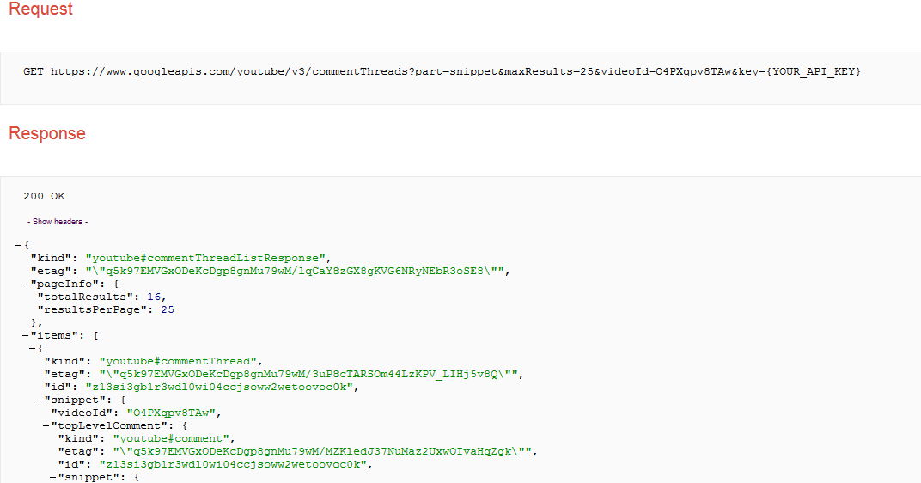
Collect and Store Data into the Data Lake
You know there is value in your
Organization’s YouTube channel,
but you don’t know what exactly
that might be.
You extract the API output weekly
& load the data into your
Hadoop Data lake.
Notes:
Common use case of Hadoop is collect output from another system, and store it as is because you don’t know how you want to analyze it yet.
You don’t know what parts of the JSON output you will need. This data is schema-less which means we don’t have to apply any logic at write-time as we would normally with a relational database management system.

Slide 65
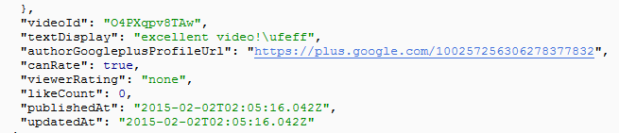
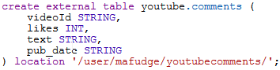
Apply a Schema on Read/Query
When we want to perform analysis on the data, we add a schema when the data are read.
This will create a table of data, like a relational table.
videoId | likes | text | pub_date
O4PXqpv8TAw | 0 | excellent video!\ufeff | 2015-02-02T02:05:16.042Z
… | … | … | …
Notes:
When we want to perform analysis on our data, we apply a schema as it is read to that it can be placed in a tabular form for analysis.
You don’t have to define a full schema to all the data – only the data you care about.
Once the schema is applied we can further process the data in tabular format.

Slide 66
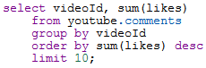
Analyze Your Data
videoId | likes | text | pub_date
O4PXqpv8TAw | 0 | excellent video!\ufeff | 2015-02-02T02:05:16.042Z
… | … | … | …
The table is not stored. It is a program that adds schema when we execute the actual analytics.
In this case, an SQL SELECT statement, but it could be any code.
Export/ Visualize
videoId | sum(likes)
O4PXqpv8TAw | 56
V56Xqyy-2wq | 14
… | …
Notes:
When your data is in tabular format you can process it further and then visualize it.
Hadoop has tools to visualize your data, you can also export the data, provided it has been reduced to a reasonable side.
The entire process can be automated so that as new data is collected it can be processed and visualized.

Slide 67
What Exactly Is “Schema on Read”? Again?
Traditional RDBMS
Hadoop
You cannot write data without a table
Cannot insert data unless data fit into table’s single design
Large up-front design costs
Conceptual models
Table design
“Schema on write”
You write the data “as they are” to the Data Lake
Schema applied when data are read—multiple designs
Very little up-front design costs
Just write to disk
Apply schema when you need it
“Schema on read”

Slide 68
Hadoop Architecture

Slide 69
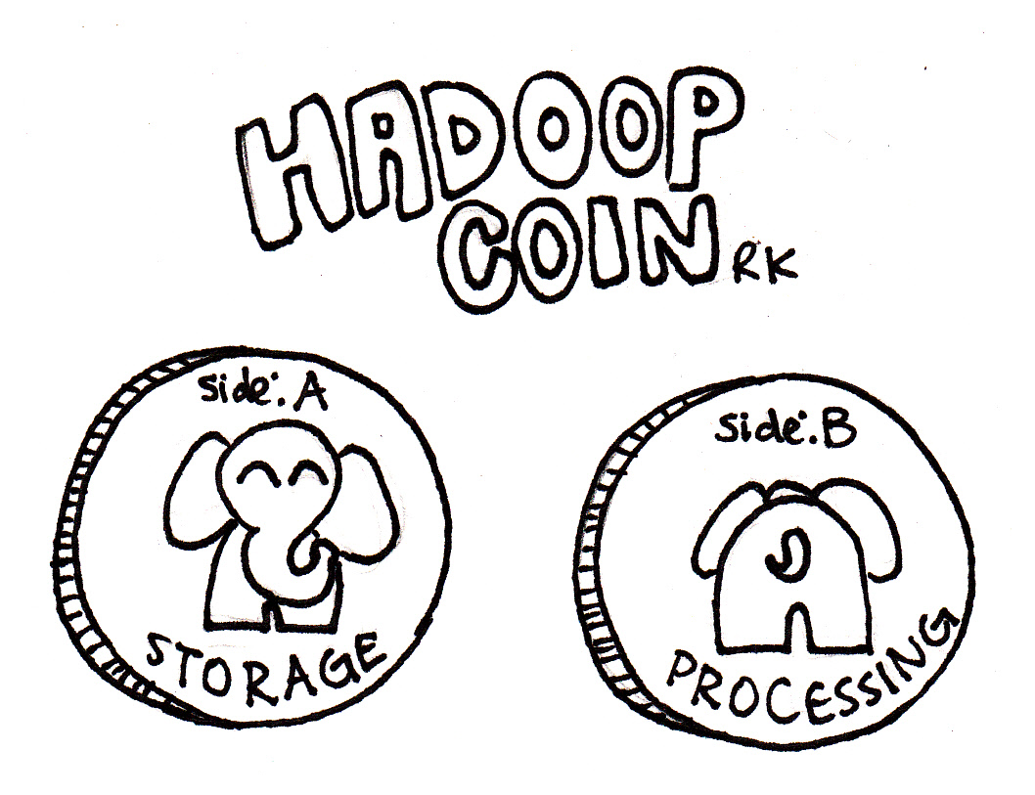
Two Essential Components of Hadoop
Distribute the data across nodes in the data lake by splitting it up. HDFS does this.
Move the compute to where the data lives. MapReduce/YARN does this.
HDFS
YARN

Slide 70


Typical Hadoop Cluster
Master Nodes
Manages the Hadoop infrastructure
Runs one of each of these services per cluster, on a single server or many
Should run on server-class hardware
Very few of these nodes
YARN:
App Timeline Server,
Resource Manager,
History Server
HDFS:
NameNode
YARN: Node Manager
HDFS: DataNode
YARN: Node Manager
HDFS: DataNode
YARN: Node Manager
HDFS: DataNode
Worker Nodes
Store data and perform processing over it
Each node runs the same services
Runs on commodity hardware
Lots and Lots these nodes
YARN: Node Manager
HDFS: DataNode
YARN: Node Manager
HDFS: DataNode
YARN: Node Manager
HDFS: DataNode

Slide 71
HDFS
Hadoop Distributed File System

Slide 72
HDFS – Hadoop Distributed File System
Based on Google’s GFS – Used by search.
CP System: NameNode master + several DataNode workers.
Distributed data storage paradigm
A single file is divided into 128MB blocks
Blocks are spread across nodes
Blocks are written multiple times for redundancy
Some 300MB File
A
B
C
DataNode 1
DataNode 2
DataNode 3
DataNode 4
A
B
C
A
B
C

Slide 73
Example: HDFS Write
Client: put file data.csv size: 500MB
NameNode
That requires 4 blocks on nodes 1-4 My Replication Factor is 3
1
2
3
3
4
3
2
1
2
DataNodes
4
3
1
4
2
1
4
5
6
Notes:
In this example we have a single namenode and 6 data nodes in our cluster.
Client makes a request to the name node to write a file.
Name node stores metadata about the file’s whereabouts (data.csv consists of 4 blocks on nodes 1-4) and instructs the client where to write the file.
The client sends its data to the data nodes. Data is written in parallel so the I/O is vastly improved over non distributed options
Each data node replicates (make a copy of its’ block) to other datanodes as instructed by the Namenode. In this example there is a replication factor of 3, so two copies are made.

Slide 74
Example: HDFS Read
Client: get file: data.csv
NameNode
You can find that on nodes 5,2,3,4
1
2
3
4
1
2
3
1
3
2
4
3
2
DataNodes
4
3
1
4
2
1
4
5
6
Notes:
In this example we have a single namenode and 6 data nodes in our cluster.
Client makes a request to the name node to read a file.
Name node knows where the data is located. The datanodes are reporting “what they have” to the name node on an interval.
The client requests the data in parallel from the data nodes.
The data in assembled in the right order by the client.

Slide 75


Example: HDFS Heartbeat and Block Report
“Sorry, DataNode 3, but I’m going to assume you are dead.”
NameNode
Heartbeat and block report
Heartbeat and block report
Heartbeat and block report
DataNode 1
DataNode 2
DataNode 3
DataNode 4
HDFS DataNodes send routine heartbeats and block reports to the NameNode.
This is how the NameNode knows where the blocks of a file are located.
Notes:
- If a DataNode fails to send a Heartbeat to the NameNode, that DataNode is labeled as dead
- Any data that was registered to a dead DataNode is not available to HDFS anymore
- The NameNode does not send new I/O requests to a dead DataNode, and its blocks are replicated to live DataNodes

Slide 76
YARN (and MapReduce)
Yet Another Resource Negotiator

Slide 77
YARN – Hadoop 2.0
YARN is a job executor and resource schedule for Hadoop.
MapReduce is a distributed batch process algorithm
Hadoop v1 could ONLY do Map-Reduce
Hadoop v2 added YARN so any distributed application could run
YARN provides an API so that you can build distributed applications on Hadoop.
YARN made applications like Spark and Hive possible.
Map-Reduce is now just one of the many applications which run on YARN

Slide 78
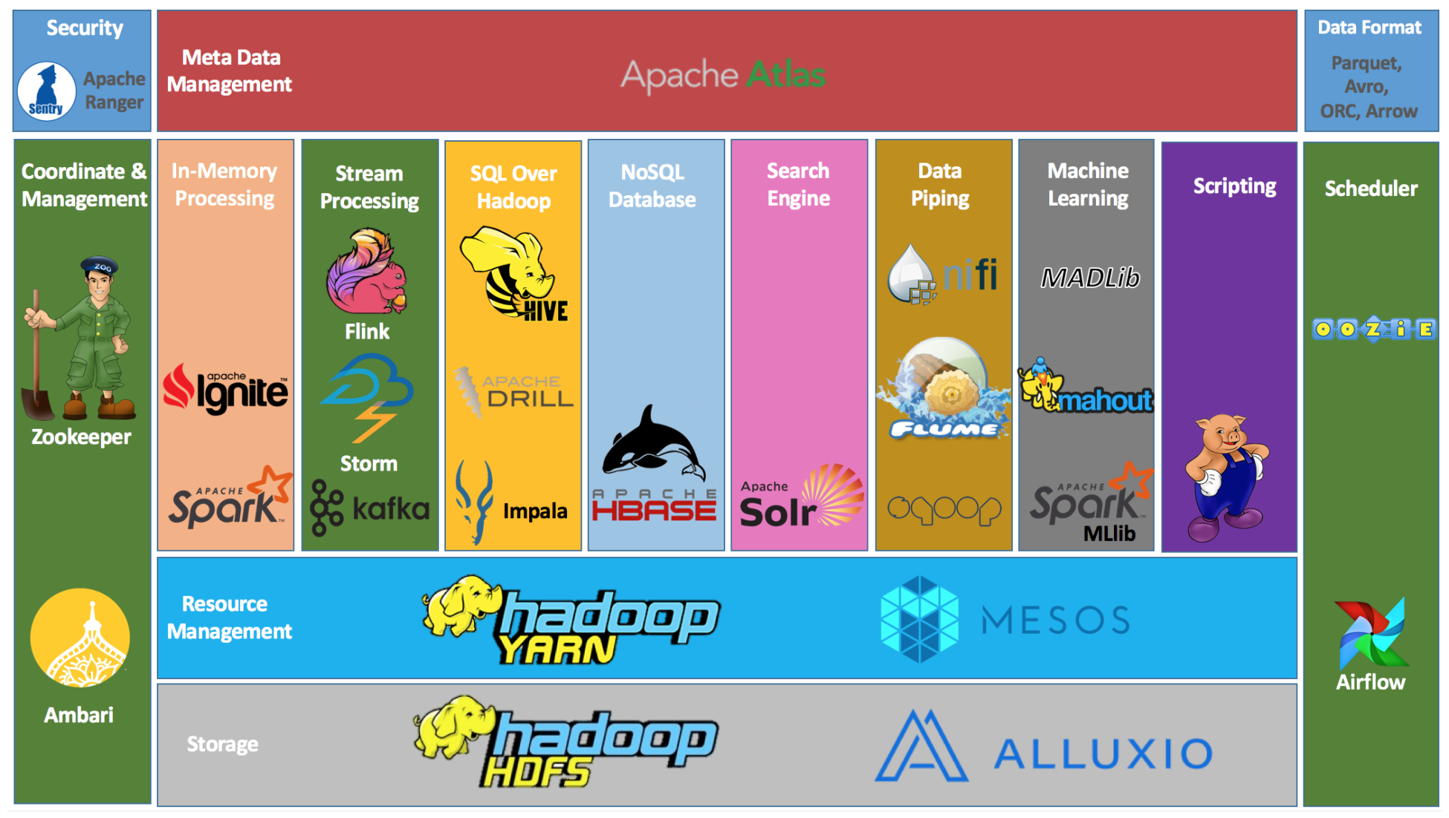
https://www.cloudduggu.com/hadoop/ecosystem/
Notes:
The Hadoop Ecosystem
DO NOT SPEND A LOT OF TIME ON THIS, INSTEAD FOCUS ON THE APPLICATIONS THAT RUN OVER YARN

Slide 79
MapReduce Algorithm
Understanding MapReduce will help you understand distributed processing.
Phases
Map → apply a transformation to a data set
Shuffle → transfer output from Mapper to Reducer nodes
Reduce → aggregate items into a single result
Combine → output of Reducer nodes into single output
Map
Shuffle
Reduce
Combine
We must supply the Mapper and Reducer functions.
Notes:
Understanding M-R is key to

Slide 80
Example MapReduce: “Total Orders by State”
Source
file
HDFS blocks each node
Mapping
Shuffle
Reduce
Combine
JAN, NY, 3
JAN, PA, 1
JAN, NJ, 2
JAN, CT, 4
FEB, PA, 1
FEB, NJ, 1
FEB, NY, 2
FEB, VT, 1
MAR, NJ, 2
MAR, NY, 1
MAR, VT, 2
MAR, PA, 3
JAN, NY, 3
JAN, PA, 1
JAN, NJ, 2
NY, 3
PA, 1
NJ, 2
CT, 4
NJ, 2 NJ, 1 NJ, 2
CT, 4 NJ, 5
JAN, CT, 4
FEB, PA, 1
FEB, NJ, 1
CT, 4
PA, 1
NJ, 1
CT, 4 NJ, 5
NY, 6
PA, 5
VT, 3
NY, 3
NY, 2
NY, 1
NY, 6
FEB, NY, 2
FEB, VT, 1
MAR, NJ, 2
NY, 2
VT, 1
NJ, 2
PA, 1 PA, 1 PA, 3
PA, 5
MAR, NY, 1
MAR, VT, 2
MAR, PA, 3
NY, 1
VT, 2
PA, 3
VT, 1 VT, 2
VT, 3
Notes:
Let’s start with a source file. This file contains the month and state and count of orders for that month/state. We would like to process this “big data” and get a count of total orders by state For example if you add up the NY orders it would be 6.
When this file is uploaded to HDFS it is broken up into blocks. The blocks are split evenly across the block size. In this example the block size chosen results in 4 blocks, conveniently one block per node. This is not always the case – just how it works out in this example.
Next we perform a mapping. The mapping phase uses the key State code to return a list of order counts. For example On the first node “NY” returns a one item list of NY,3.
Next we must move data to the reducer nodes. This is called a shuffle. The shuffle can be the most I/O intensive part of the process. In this example we have 4 reducer nodes (the same number of mappers and data nodes) data is shuffled to reducer so that each node can process its data in parallel.
In the reduce phase we take our key and apply an aggregate function to the data. For example in this case if we look at the first reducer node it will sum up the orders by key state.
At this point the map-reduce is complete and 4 files are written to HDFS (one for each reducer) we can combine these files easily to produce a single output.

Slide 81

HIVE
SQL Over Hadoop HDFS

Slide 82
What is HIVE?
SQL on Hadoop
Apply a table schema over the data in HDFS
Schema is not persistent – its “schema on read”
Not standard SQL, but HiveQL – HQL
Developed by Facebook, Now Apache Foundation
Hcatalog / Hive metastore provides table access to other tools in the Hadoop ecosystem.

Slide 83

Hive Architecture
HQL
Hive Client
Middleware JDBC/Thrift
Hive Server:
Meta store, Command Parser, Query Planner/Optimizer
YARN Job
YARN
HDFS

Slide 84

Hive Metastore
The Hive metastore holds schema / metadata information for hive database objects:
Databases
Tables
Views
Indexes
The metastore is commonly an RDBMS
The actual data itself are stored on HDFS.
Order Schema
Metastore:
HDFS:
Order Data
SELECT * FROM orders;

Slide 85
Two Types of Hive Tables
Internal (Hive-Managed)
External
Data and Schema are managed by the Hive, like an RDBMS
Data are moved into a special HDFS folder /user/hive/warehouse
Drop table → deletes data
Insert into table via Hive SQL
Table over existing HDFS location
Only the schema is managed by the Hive
Drop table → deletes the schema only
Insert into table by adding files to HDFS

Slide 86
Query Hive Like SQL!
Once tables are created, they can be queried with SQL
SELECT * FROM customers;
FROM customers SELECT firstName, lastName, address, zip WHERE orderID > 0 ORDER BY zip;
SELECT c.*, o.* FROM customers c JOIN orders o ON c.customerID = o.customerID;
Notes:
This is a simple slide that is meant to demonstrate how Hive queries look exactly like SQL queries.
You can even do joins, left, right and full outer joins.

Slide 87

Spark
Lightning-Fast Cluster Computing

Slide 88
What is Spark?
General-purpose distributed data processing / computing engine for large-scale data analytics
Developed at UC Berkeley AMP Lab, Now an Apache project, and heavily funded by Databricks.
Designed from the ground-up to support distributed data processing.
Stores working data in memory for fast processing.
Best suited machine learning tasks and interactive / exploratory analytics

Slide 89
Spark: Key Features
Underlying API supports multiple language bindings
Scala, Java, Python, R and SQL.
You can use the APIs of these languages in Spark, provided the libraries are installed on the nodes in the cluster.
Uniform data access.
Connect to any data source and manipulate it the same way courtesy of the RDD (Resilient-Distributed Data) and Data Frames APIs.
Makes data manipulations consistent regardless of where the data came from.

Slide 90
Spark Use Cases
Interactive/exploratory analytics including machine learning tasks
Real-time analytics and event processing
Building data pipelines and Extract-Transform Load pipelines
Machine learning on big data, creating ML pipelines

Slide 91
Spark Libraries
Four libraries built on Spark Core
MLlib: a machine learning library, similar to sklearn
Spark Streaming: enables high-throughput, fault-tolerant stream processing of live data streams
Spark SQL: runs SQL and HiveQL queries, Dataframes
GraphX: an API for graphs and graph-parallel computation
Spark SQL
Spark Streaming
MLlib (machine learning)
GraphX (graph)
Apache Spark Core

Slide 92
Spark Execution modes
Client
Code executes locally
Behaves identically to cluster mode
Limited to the computing capacity of the running machine
Cluster
Code executes on cluster.
Supports YARN, Mesos, Kubernetes or standalone spark cluster
Horizontally scalable.
Driver Program
Spark Context
Worker Node
Executor
Cache
Task
Task
Worker Node
Executor
Cache
Driver Program
Task
Task
Spark Context
Cluster Manager
Worker Node
Executor
Cache
Task
Task

Slide 93

PySpark Programming
Spark programming in Python

Slide 94
Essential Spark Concepts
Resilient Distributed Datasets (RDDs)
Basic building block of all spark storage.
Abstracts away the need to worry about where data is and whether its available.
Lazy Evaluation
No RDD transformations take place until we execute a command that requires output
Directed Acyclic Graph (DAG)
The execution plan generated from the spark code is finite and deterministic.
Your code does not execute in the order written.

Slide 95
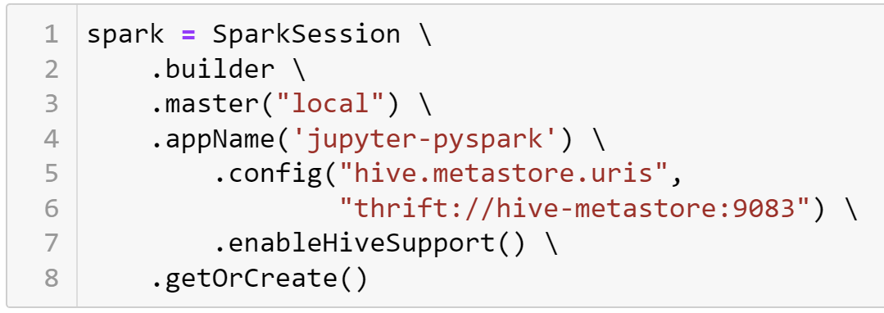
Creating A Spark Session
“local” means client mode
appName is useful for cluster deployments
config() can be used multiple times

Slide 96
Spark Jars
Spark Jars allow us to plug in additional spark libraries and integrations.
Search here for Jars https://maven.org
What you need to know:
Our Spark Version: 3.1.2
Our Scala Version: 2.1.2
Package String is the gradle DSL implementation
Add package string to spark session: .config("spark.jars.packages","gradle-package-string")\

Slide 97
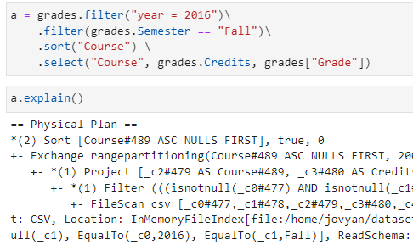
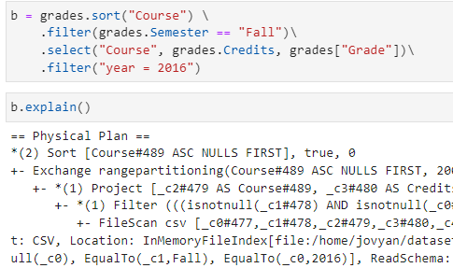
Lazy Evaluation and the DAG
Lazy evaluation assures nothing executes until a result it yielded
Code is optimized to an execution plan. These two use the same plan.

Slide 98
Data Storage Options for Spark
HDFS seems like the logical choice, but:
Requires Hadoop and YARN
Requires Spark cluster running on YARN
You want to use Spark but don’t want to setup and manage Hadoop!
Hive Integration
Object Storage
Distributed NoSQL databases
MongoDb, Elasticsearch, Cassandra, etc…

Slide 99
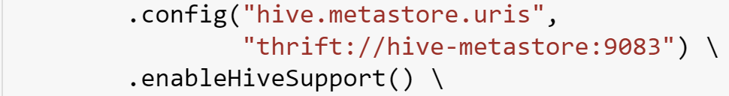
Hive Integration with Spark
We can use spark.sql to execute hive queries when enableHiveSupport() is configured.
We Need to use .show() to force lazy evaluation of the SQL!
We can read HDFS data through Hive but not directly. If its not a Hive table, its not available in Spark.

Slide 100
What is Object Storage?
Cloud-based Network-Attached storage
Client uses an API such as the AWS S3 API to get and put objects.
Popular Object Storage Providers
AWS S3 (Simple Storage Service)
Azure Blob Storage
Google Cloud Storage
Minio (open source)
Very popular storage option for spark in the cloud.
Even easier with delta lake https://delta.io/

Slide 101
Spark DataFrames API
Declarative API for Working with Tables of Data

Slide 102
Understanding Spark File Paths
Spark can read from/ write to files at variety of locations.
Locations:
file:// local (on spark client)
s3a:// object storage (Minio / S3 / Azure Blob)
hdfs:// Hadoop HDFS
webhdfs:// Hadoop over Web HDFS
The path can be a filename, folder, or wildcard
stocks.csv | stocks/ | stocks/jan*.csv
Example:
hdfs://namenode/path/to/files

Slide 103
Reading Data, the Spark Way
It doesn’t make sense to load a local file with the client, especially when you are running spark in cluster mode.
The SparkFiles module allows us to load the files into the temporary storage on the worker nodes of the spark cluster.
We can also read data over HTTP using this method.

Slide 104
Spark File Formats
Spark can read / write data in a variety of formats.
csv delimited (comma, tab, etc) file
text generic text file, one row per line
json JSON format
parquet Parquet format (common big-data format with schema included)
orc Another common big-data format with schema.
Each format has configurable options.
https://spark.apache.org/docs/latest/sql-data-sources.html

Slide 105
DataFrame Schemas
Every spark dataframe has a schema, or collection of typed columns. The schema is stored in a StructType
Each column is a StructField consisting of the field name and a specific StructType. Int, decimal, string, date, etc..
When you spark.read data, from the schema is always the most flexible type, String.
When you include the inferSchema option, and extra pass is made over the data to infer the `StructType` for each column.
For formats that include a schema, like `parquet` or `orc` the schema in the file is loaded.

Slide 106
What does .cache() do?
spark.load.csv("s3a://bucket/file").cache()
Minio
Or S3
Distribute data to the workers so that data does not need to be fetched at lazy evaluation.
Spark Workers

Slide 107
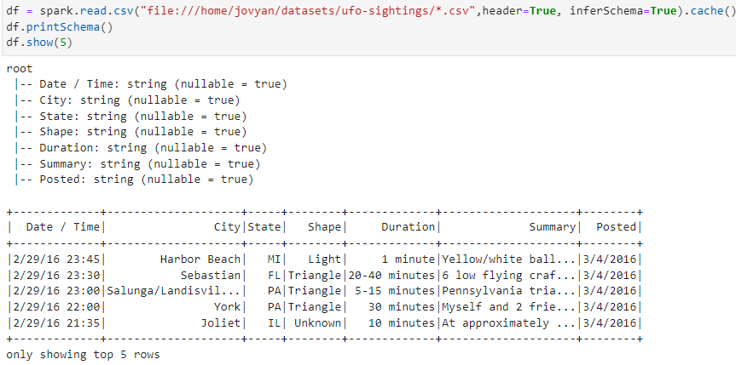
Example: Schema, inferSchema and Cache

Slide 108
Spark Transformations

Slide 109
Too Many Transformations to Do Here!
Examples are In the Pre-Recorded Video!
For Reference:
/work/examples/PySparkCookbook.ipynb
/work/content/2-Object-Spark.ipynb
https://sparkbyexamples.com/pyspark-tutorial/

Slide 110
Evolution of SQL on Big Data
From Data Warehouses, To Data Lakes, to Serverless Data Warehouses

Slide 111

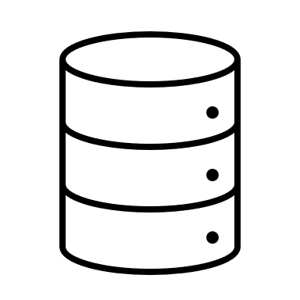


RDBMS Data Warehouses
Organizations use data warehouses for business intelligence and data analytics.
Data in the DW is heavily cleaned and transformed
SQL Query
Orders
Heavy Data Transformations (ETL)
Analytics:
Who buys what?
When is it bought?
Customers
Cleaning
De-normalization
Data Lookups
Data Warehouse
(Relational Database)
Products

Slide 112




Hadoop Data Warehouse
Modern data is complex and comes from a variety of sources (polyglot).
Relational Db DW cannot keep up with the data volume, so we use Hadoop.
Store As-Is
Hadoop
Data Lake
SQL Query (Hive)
Reviews
Orders
Non-Relational
Sources
Heavy Data Transformations (ETL)
Analytics:
Who buys what?
When is it bought?
What products are people talking about?
Verified purchases.
Customers
Web Logs
Relational
Sources
Relational Database Data Warehouse
Products
Social Media

Slide 113
The Serverless Data Warehouse
Large up-front investment make Hadoop costly and impractical for all but the largest of use cases.
Agility is needed to query data from anywhere especially as cloud adoption increases.
Reviews
Direct SQL Query
Orders
→RDBMS Connector for Customers, Orders Products
→ S3 connector for Reviews and weblogs
→ HTTP connect for social media API’s
Analytics:
Who buys what?
When is it bought?
What products are people talking about?
Verified purchases.
Customers
Web Logs
Products
Social Media

Slide 114
Direct SQL Query
Query any source of data with SQL
Any Sources? Just about any!
Hadoop, Object storage, Local Files, Web API’s
Relational Databases, NoSQL Databases, Streaming Databases
Cloud Providers:
AWS Athena, Google BigQuery
Open Source:
Apache Drill, Presto, Trino, Apache Spark SQL

Slide 115

Spark SQL

Slide 116
DataFrames to SQL Tables!
Register the DataFrame as a SQL View
Query it With SQL!!!
ANSI Compliance https://spark.apache.org/docs/3.1.2/sql-ref-ansi-compliance.html
SQL Syntax https://spark.apache.org/docs/3.1.2/sql-ref-syntax.html

Slide 117
Spark SQL
Use .createOrReplaceTempView() to register a dataframe as a temp SQL view, valid for the current session.
Then use spark.sql() to query it!
The result is another DataFrame
Example:
df.createOrReplaceTempView("sometable")
spark.sql("select * from sometable").show()

Slide 118
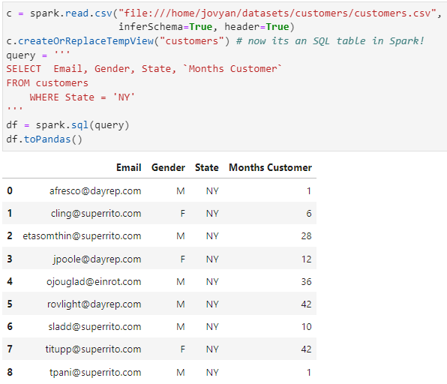
Example of Spark SQL

Slide 119

Document Database
What is a Document Database?

Slide 120
What Exactly is a Document Database?
Designed to store semi-structured data, in JSON or XML format. This is the “Document”
Full CRUD support.
Documents Stored in Collections; Fetched by Key
Keys can be surrogate or assigned.
Keys are unique to the collection
Popular Document Databases”
AWS Document Db
Google Firebase
MongoDb
CouchDb

Slide 121
Typical Document Db Data Model
Database
Boundary for one or more collections
Collection
A subject area for documents to be stored
Document
An individual subject in a collection

Slide 122
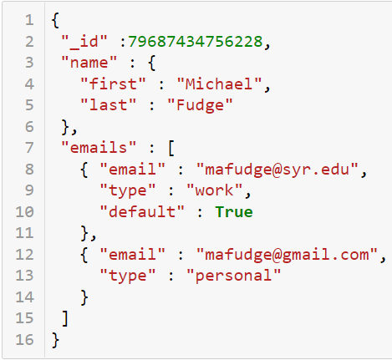
The Document (JSON Example)
Tree-like structure
Multiple Keys / Values Pairs
A Document has composite data
Self-Describing (Schema is with the data)
No rigid schema. Anything can be saved in the collection.
Ask for something not there? → null

Slide 123
Document Database Use Cases
Good For ☺
No So Good For ☹
Collections of complex data attributes associated with a single entity.
Items retrieved as a whole
Examples:
Content Management
Product Catalogs
Immutable Data (Orders History)
Complex Data Relationships
Retrieving “Part” of the Document
Data with a high rate of change

Slide 124
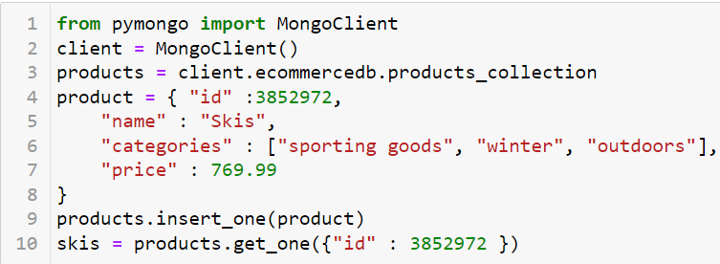
Document Databases are Programmer Friendly
Read and Store Complex Data
No Schema is Required, No SQL is Required
Simple CRUD, Limited support for partial updates, usually you must retrieve the entire document.

Slide 125

Relational vs Document
Comparison of the Two Models
Differences in design approaches

Slide 126
Relational vs. Document
Relational
Document
Designed for use by database administrators
Complex data model, normalized
Flexible, performant query operations
Related information stored in individual tables
Data redundancy is exception to the rule
Domain-Specific Query Language (SQL)
Designed for use by programmers/developers
Simplified data model, denormalized
Query not as performant
Related information stored with document
Data redundancy is expected
Non-Domain Specific Query Language

Slide 127
Customer: The Relational Way
Customer has many other entities like phones and addresses
We can update phones / addresses independent from customer
Data in 3rd Normal Form; Data Integrity
Keys. Keys everywhere!
Customer Phones
Cid (PK, FK)
Order (PK)
Phone number
Number type
Customer Addresses
Cid (PK, FK)
Aid (PK, FK)
Address type
Customers
Cid (PK)
Email
First name
Last name
Addresses
Aid (PK)
Street
Postal_code (FK)
Postal Codes
Postal_code (PK)
City
State
Notes:
Explain what you see, then
Pros and cons:
Highly normalized. Concerns are separated. i.e there’s a table with only phone numbers in it.
Schema before data (we make these tables before we can insert rows. This allows for constraints to ensure addresses have valid zip codes at the data access layer.
To add a customer we require many writes. At least one to each of these 5 tables, if not more.
Foreign keys are required to tie the tables together into a single conceptual entity “Customer”

Slide 128
Customer: The Document Way
{ cid : 1, email: mafudge@syr.edu, first name: Michael, last name: Fudge, phones: [ { type : home, number: 555-1234 }, { type : cell, number: 555-9283 } ], addresses: [ { type: billing, street: 1313 Mockinbird Ln, city: Syracuse, state: NY, zip: 13244 } ] }
Self-Describing / Schema-less
Denormalized; all related data stored together.
Data Integrity shifts from data logic to business logic.
Easier to store, harder to query.
Do two customers have the same address?
Notes:
Simplified data model – reading and writing one “thing” the document.
Pros and cons:
Schema-less. The labels are written with the actual data. If I need to add middle initial, I just write it.
Write all the data at once with the conceptual entity.
Harder to perform cross-cutting queries, such as getting a list of phone numbers, or finding two people who share the same address.
Burden of data integrity shifts from the database management system to the application’s business logic layer.

Slide 129
Designing for Document Databases
ER Modeling works. Entities are documents in the collection.
Reference-Oriented Data
Store composite, Multi-Valued with main Entity
Ensure Slow Rate of Change. High rate of change is not a good use case.
Can support full CRUD
Process-Oriented Data
Design to be Immutable or Historical
Should support only CR (no updates or deletes)
Minimize the number Entities and Relationships.

Slide 130
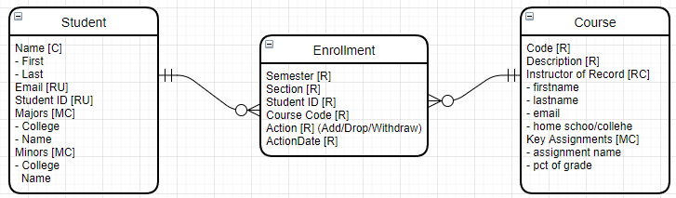
Example: Student Enrollment
Each entity is an example of a document in a collection. 3 Collections.
Student and Course are reference-oriented. Composite data such as majors, minors get stored with student. Full CRUD support for these collections.
Enrolment is process-oriented but designed to be document immutable. When a student drops another document is added.

Slide 131

Mongo Db
Architecture

Slide 132
MongoDB
Document Database
Database → Collections → Documents
Documents are JSON Schemas
Single Master Architecture
Scales well horizontally, but has a single point of failure
Supports Consistent reads
Supports sharding with data replication
Data Model
Document data model—schema-less
Every document stored has a key
Uses JavaScript as a query language and JSON as a data format
There are only integrity constraints on the key; it must be unique per collection
Custom query language MQL
Based on JavaScript

Slide 133
Mongo Db And Data Integrity.
Document databases are incredibly flexible and do not complain about missing schema.
No Database? I’ll make that for you.
No Collection? I’ll make that for you.
Add the same thing twice… no biggie I pick the key for you!
Add people to the books collection. I’ll gladly do that for you!
You are responsible for data integrity.

Slide 134
Two Key Concepts of Distributed Data
Sharding
Replica
Splits the data into partitions so that each node hosts part of it
Distributes the I/O over several hosts; for performance
Data distributed to nodes based on shard key strategy
https://docs.mongodb.com/manual/sharding/
Synced copies of shards on different nodes
Each replica contains an exact mirror of the shard
For Fault-Tolerance
https://docs.mongodb.com/manual/replication/
Notes:
The essence of Horizonal Scalability

Slide 135
MongoDB Cluster Visualized
Consider a mongo database, with a collection of documents mapped to sets A, B and C.
A
B
C

Slide 136
MongoDB Cluster Sharding
It is sharded into three nodes. Each node (hosts 1–3) has different data—no single node has the same data.
Each Host holds a single shard.
Host 1
Host 2
Host 3
A
B
C

Slide 137
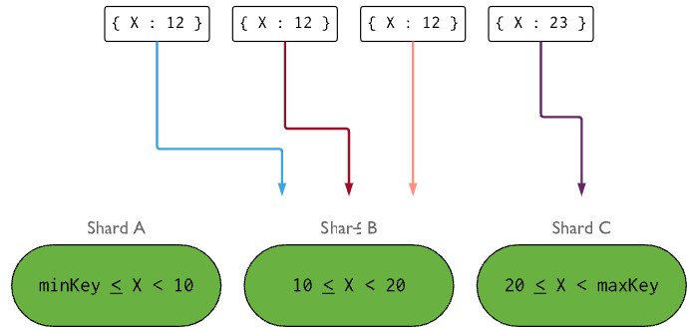
Shard Key
The Shard Key determines how the data are distributed to the nodes.
Two approaches:
Range key
Hash key
We want even distributions for the best performance.
Range key example →

Slide 138
MongoDB Cluster Replication
Each of the three nodes has one replica. Hosts 4–6 are a mirror copy of hosts 1–3, respectively.
For fault-tolerance we add nodes.
Host 1
Host 2
Host 3
A
B
C
Host 4
Host 5
Host 6
A
B
C

Slide 139
Mongo Db Query Language (MQL)
Commands in MQL (Mongo Query Language)

Slide 140
MQL: Create and Read
use database
show collections
db.collection.insertOne(jsonData)
db.collection.insertMany(arrayJsonData)
db.collection.find(query,projection)
db.collection.replace(query,jsonData)

Slide 141
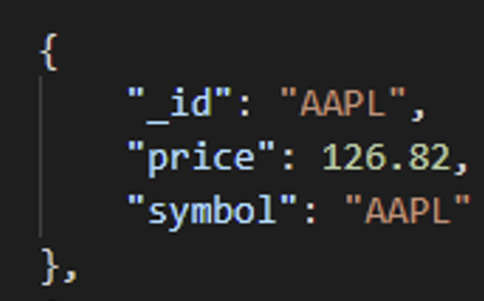
MQL Query Example
db.collection.find(query, projection)
db.stocks.find( {“symbol” : “AAPL”}, { “symbol”:1, “price”:2}
)
https://docs.mongodb.com/manual/tutorial/query-documents/

Slide 142
MQL ←→ SQL
https://docs.mongodb.com/manual/reference/sql-comparison/
Good reference that provides the SQL equivalent of just about every MQL query.

Slide 143
Wide Column Database
What is a Wide Column Database?

Slide 144
What Exactly is a Wide Column Database?
Also known as “Big Table” database or extensible record store.
Model consists of:
Tables with columns where any value can be null.
Every table has a row key, value is retrieved by column key
No table joins
Cloud Offerings
Google Bigtable
Azure Tables
AWS DynamoDb
Hadoop Hbase

Slide 145
Wide Column Visualized
Columns are stored under a row-key, efficient storage for wide tables with many columns with nulls.
Row Key | Name | Year | GPA
1 | Anne | Freshman | 3.2
2 | Bette | Freshman
3 | Chris |  | 3.5
4 | Dave
5 | Erin | Junior
6 | Fred |  | 4.0
Row Key | Name
1 | Anne
2 | Bette
3 | Chris
4 | Dave
5 | Erin
6 | Fred
Row Key | Year
1 | Freshman
2 | Freshman
5 | Junior
Row Key | GPA
1 | 3.2
3 | 3.5
6 | 4.0

Slide 146
Use cases
Storing vast amounts of immutable, process-oriented data
Orders, Stadium Attendance, Tracking vehicle movement in real-time.
Time-Series Data
IoT Telemetry (data created by IoT devices)
Health tracker data, Weather Data, User activity
Applications with Specific Query Flow
Search a Region → Select Hotel in Region → Select available Room in Hotel
Find a student by name or id → Select course → view all submitted assignments

Slide 147
Wide Column Good And Bad
Good For
Not Good For
Time Series Data
Guaranteed Writes
High Write Volume
Process-Oriented Data
Queries across a single subject
“Orders”
“Uber Trips”
General Purpose Database design (Like Relational or Document)
Ad Hoc Queries (querying it any way you want)
Data Warehouses (reads are slow)
Data that must be normalized
Reference-Oriented Data

Slide 148
Typical Applications
Any time series data
IoT applications
User activity tracking
Performance monitoring
Social media analytics
E-commerce Transactions
Messaging

Slide 149
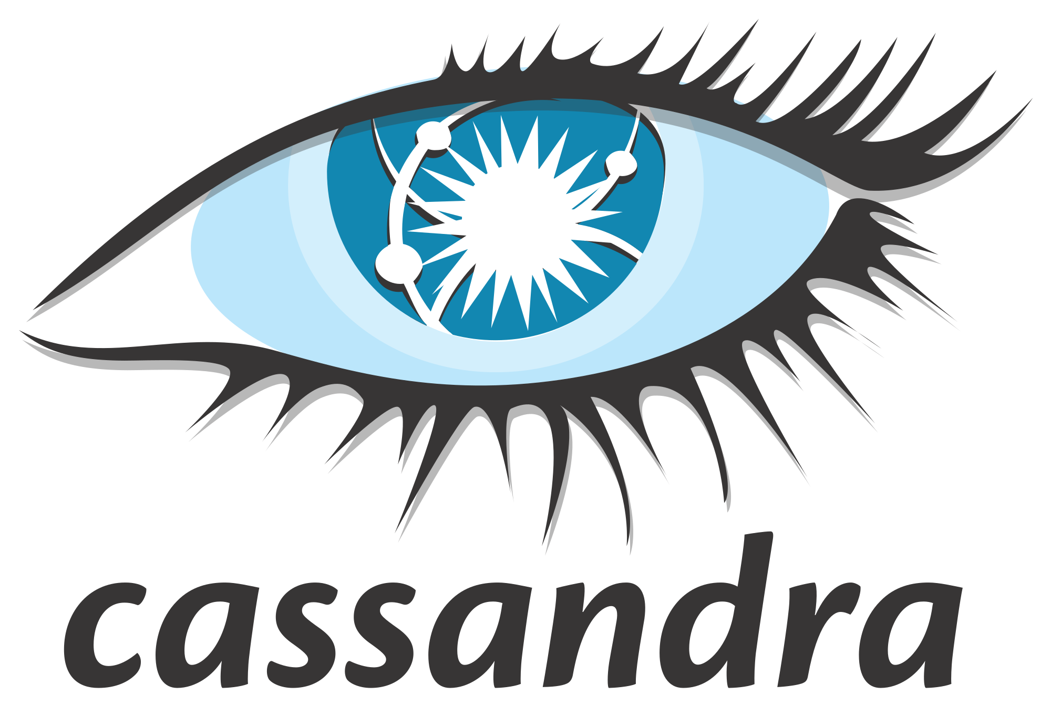
Cassandra
Open Source Wide-Column Database

Slide 150
Cassandra
Developed Originally by Facebook
Developed by Facebook, open sourced in 2008
Inspired by Google Bigtable and Amazon DynamoDB papers
Eventual Consistency (BASE)
Can always write, but not guaranteed to read, the same thing
Scales well horizontally
AP System – no single point of failure
Data Model
Distributed wide-column store database
Key maps to one or more columns
Has an SQL-like query language CQL
Tables must exist prior to data being stored
There are no data integrity constraints, no table joins.

Slide 151
Databases the Cassandra Way
Query design influences table design. Build your tables based on how you will query the data back out.
Redundant, de-normalized data, including different versions of the same conceptual entity
One large flat table per query.

Slide 152
Cassandra Ring Architecture
All nodes play the same role
All nodes communicate with each other
There is no “single master” like MongoDB, Redis, and RDBMS solutions
Data replicated to other nodes.
No single point of failure
To scale—add more nodes!
You can configure replication and number of replicas

Slide 153
Cassandra Data Model

Slide 154
Cassandra Data Model at a Glance
Cluster: a collection of Cassandra nodes
Keyspace: a container for data tables and indexes; this is like a “database” in a RDBMS; defines the replication strategy
Table: similar to a RDBMS table, but all columns are optional “wide column store” implementation
Row key: used to uniquely identify a row in the table and to distribute the rows across the cluster
Consists of a Partition key and a Cluster key
Index: similar function as an RDBMS index

Slide 155
Tables
Tables similar to RDBMS tables, except since there are no “joins” in Cassandra; the tables should be highly de-normalized and wide (many columns)
Cassandra tables are best suited for the capture of events such as orders, sensor readings, and so on; these data are usually time series
Tables are in wide-column store format; this means that all columns are NULLABLE, so there are no integrity constraints
Use the CREATE TABLE statement to make tables
https://cassandra.apache.org/doc/3.11/cassandra/cql/ddl.html#create-table-statement

Slide 156
Row Keys Are Important
Must uniquely identify a row, but will also limit how we can retrieve rows.
The first attribute in the row key list is the partition key. This value is hashed, and the value determines to which node in the ring the data are written. (similar to a MongoDb shard)
Any additional parts of the row key are the clustering key, which determines the order by which the data are written to that node (similar to an RDBMS clustered index).
To retrieve rows, you must include values from row key.

Slide 157
The Row Key: Partition + Cluster Key
Partition key—distributes data across nodes
Clustering key—sorts data within a node

Slide 158
The Cassandra Cluster Data Visualized

Slide 159
Cassandra Cluster Visualized
Let’s assume that we have a cars table with:
Partition key = make
Cluster key = model
Writing the following data:
Make | Model
Node 1
Node 2
Node 3
Make | Model
Make | Model

Slide 160
Cassandra Cluster Visualized
Let’s assume that we have a cars table with:
Partition key = make
Cluster key = model
Writing the following data:
Chevy Volt
Make | Model
Chevy | Volt
Node 1
Node 2
Node 3
Make | Model
Make | Model

Slide 161
Cassandra Cluster Visualized
Let’s assume that we have a cars table with:
Partition key = make
Cluster key = model
Writing the following data:
Chevy Volt
Toyota Prius
Make | Model
Chevy | Volt
Node 1
Node 2
Node 3
Make | Model
Toyota | Prius
Make | Model

Slide 162
Cassandra Cluster Visualized
Let’s assume that we have a cars table with:
Partition key = make
Cluster key = model
Writing the following data:
Chevy Volt
Toyota Prius
Chevy Cruze
Make | Model
Chevy | Cruze
Chevy | Volt
Node 1
Node 2
Node 3
Make | Model
Toyota | Prius
Make | Model

Slide 163
Cassandra Cluster Visualized
Let’s assume that we have a cars table with:
Partition key = make
Cluster key = model
Writing the following data:
Chevy Volt
Toyota Prius
Chevy Cruze
Jeep Wrangler
Make | Model
Chevy | Cruze
Chevy | Volt
Node 1
Node 2
Node 3
Make | Model
Toyota | Prius
Make | Model
Jeep | Wrangler

Slide 164
Cassandra Cluster Visualized
Let’s assume that we have a cars table with:
Partition key = make
Cluster key = model
Writing the following data:
Chevy Volt
Toyota Prius
Chevy Cruze
Jeep Wrangler
Ford Fusion
Make | Model
Chevy | Cruze
Chevy | Volt
Ford | Fusion
Node 1
Node 2
Node 3
Make | Model
Toyota | Prius
Make | Model
Jeep | Wrangler

Slide 165
Cassandra Cluster Visualized
Let’s assume that we have a cars table with:
Partition key = make
Cluster key = model
Writing the following data:
Chevy Volt
Toyota Prius
Chevy Cruze
Jeep Wrangler
Ford Fusion
Toyota Camry
Make | Model
Chevy | Cruze
Chevy | Volt
Ford | Fusion
Node 1
Node 2
Node 3
Make | Model
Toyota | Camry
Toyota | Prius
Make | Model
Jeep | Wrangler

Slide 166
Cassandra Cluster Visualized
Let’s assume that we have a cars table with:
Partition key = make
Cluster key = model
Writing the following data:
Chevy Volt
Toyota Prius
Chevy Cruze
Jeep Wrangler
Ford Fusion
Toyota Camry
Jeep Compass
Make | Model
Chevy | Cruze
Chevy | Volt
Ford | Fusion
Node 1
Node 2
Node 3
Make | Model
Toyota | Camry
Toyota | Prius
Make | Model
Jeep | Compass
Jeep | Wrangler

Slide 167
Cassandra Query: Partition Key Matters
I can query by make:
SELECT * FROM cars WHERE Make = ‘Toyota’
I can NOT query by Model
SELECT * FROM cars WHERE Model = ‘Compass’
Make | Model
Chevy | Cruze
Chevy | Volt
Ford | Fusion
Node 1
Node 2
Node 3
This is because 1. can determine which node participates without asking other nodes. (‘Toyota’ hashes to node 2)
Every node must be “asked” if they have ‘Compass’
Make | Model
Toyota | Camry
Toyota | Prius
Make | Model
Jeep | Compass
Jeep | Wrangler

Slide 168

Wide Column Database Design
Data Modeling for Cassandra

Slide 169
Data Modeling
Relational
Wide Column
Complex data model, normalized
Flexible, performant Ad hoc filter operations on any column.
One table per entity set, FK’s represent data relationships
Table joins
Data redundancy is undesirable
Flat model, denormalized
Can only query by row keys no filters on non key data
One table per query type with related data in table.
No table joins
Data redundancy is expected

Slide 170
Designing For Wide-Column
Design by Query: How will the data be retrieved?
Process-Oriented Data is the Appropriate use case.
Keys matter!
Partition key should be used limit the number of nodes that need to participate in the query. One is ideal.
Cluster key should be sequential (surrogate, timestamp, etc..) to ensure data is appended to the end, and not inserted into the middle.

Slide 171
Enrollment: The Relational Way
Courses are offered as classes.
Students enroll in classes.
Enrollment status
Add
Drop
Withdraw
Enrollments is a business process, the rest are reference-oriented Data
Enrollments
Sid (PK,FK)
Cid (PK,FK)
Enroll Date
Enroll Status (FK)
Students
sid (PK)
Email
First name
Last name
Classes
Cid (PK)
Code (FK)
Semester
Room
Courses
Code (PK)
Title
Credits

Slide 172
Enrollment: The Wide Column Way
No Surrogate keys.
Design by Query:
Q1: Find course sections ( search by course number, retrieve sections)
Q2: Find Section enrollments ( with class id, retrieve enrollments)
No joins so we must embed columns
PK = Partition Key, CK = Cluster Key
Cannot search by semester. Need a different table or materialized view for that!
ClassesByCourse
ClassNo (CK)
Code (PK)
Semester
Room
Course {Title, Credits}
Instructor {Name, Phone, Office, Email}
EnrollmentByClass
ClassNo (PK)
Student Id (CK)
Student {name, email}
Enrollment Date
Enrollment Status

Slide 173

Graph Data Model

Slide 174
Graph Databases
The Graph Data Model consists of Nodes and Edges
Nodes are like Entities. They have a type and attributes.
Edges connect nodes. They can be one-way or two-way.
Edges can carry attributes as well
User: Tom
Sales Team
Sales Team
Employment
Reference To
User: Harry
User: Dick
Supervises
Exp: 2027
Notes:
EXPLAIN THE EXAMPLE:
Tom, Harry and Dick are on the Sales Team
Harry was an employment reference to Tom (but not vice-versa)
Dick supervises Harry until 2027

Slide 175
Graph and The Relational Equivalent
Graph
Relational
Node Label
Node
Node Property
Relationship
Relationship Direction
Relationship Attributes
Table
Row in Table
Column in Table
Foreign Key
(No equivalent)
Associative Entity / Bridge table

Slide 176
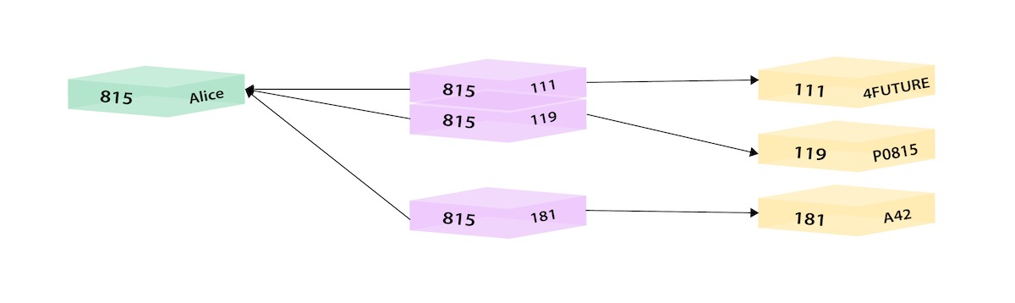
Relational: “Employees and Departments”
Many-to-Many, Requires an Associative Entity/Bridge Table
Notes:
Walk through this example

Slide 177
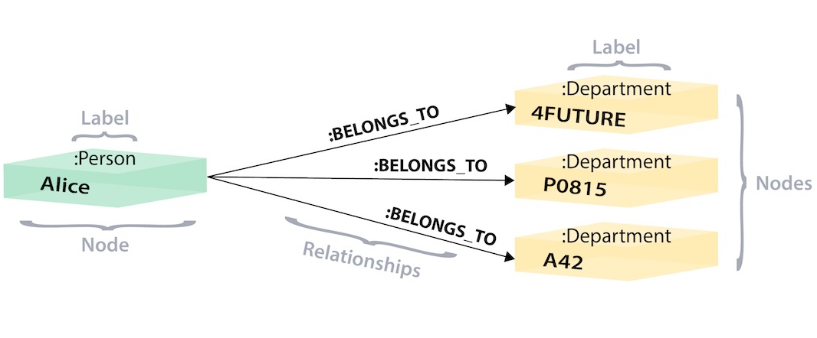
Graph: “Employees and Departments”
Entities are Labeled Nodes. Relationships are pointers to other nodes.

Slide 178
Why Graph instead of Relational?
Relational is not good for complex relationships
One-way Relationships (Most Common)
Paying an Invoice, Enrolling in a course
Recursive Relationships (Parent-Child)
Organizational Charts
Product Categories
Security Permissions
File Systems
Complex Relationships (True Graphs)
Email Interactions / Social Media – Community detection
Path finding
Centrality – like Google’s PageRank Algorithm

Slide 179

Neo4j
Open Source Graph Database

Slide 180
Neo4j
Open-Source Graph Model Database
ACID-Compliant (CP System: Scales Through Single Master)
Commercial Version supports High-Availability
Custom Query Language called Cypher
Written in Java
Very performant:
Can handle billions of nodes on a single instance
Can traverse 1000’s of relationships in sub-second time

Slide 181
Neo4J Physical Data Model
Each Node Contains:
ID - Globally Unique
Labels
Attributes
Defined Relationships
Pointers to other nodes that satisfy the relationship
Relationship data stored, not calculated
Faster than relational indexing
Can’t be queried with Standard SQL – Need a different Language
Diagram shows 3 nodes, but these are all stored together.
Customer: 1
Name: bob
ORDERS:
Number: 1234 <product ptr>
Number: 1234 <product ptr>
Product:
AB12
Amount: $25
Name: Mouse
Product:
AB17
Amount: $75
Name: Keyboard
Notes:
WALK THROUGH EXAMPLE
NODES
Customer Label
Has ID 1
Name Attribute with value “bob”
ORDERS relationship with Number attribute and value 1234 points to Product AB12
Another one points to AB17
Product Label
Node has ID: AB12
Amount Attribute has value $25

Slide 182
Neo4j Logical Data Model
Community Edition limited to single database - neo4j
Labels allow us to group common nodes together. :Label
These are like a table, but with no required schema!
They just categorize common nodes.
Relationships connect nodes together –[RELATIONSHIP]->
Relationships are one way or two way
Attributes – key value pairs {key:value}
Can be assigned to nodes or relationships
Every node and relationship gets its own id, globally unique to the db.
(f:Faculty {name:'Mike’}) -[r:TEACHES {semester:'fall2021'}]-> (c:Course {code:'IST769'})

Slide 183
Cypher Basics
Cypher Query Language

Slide 184
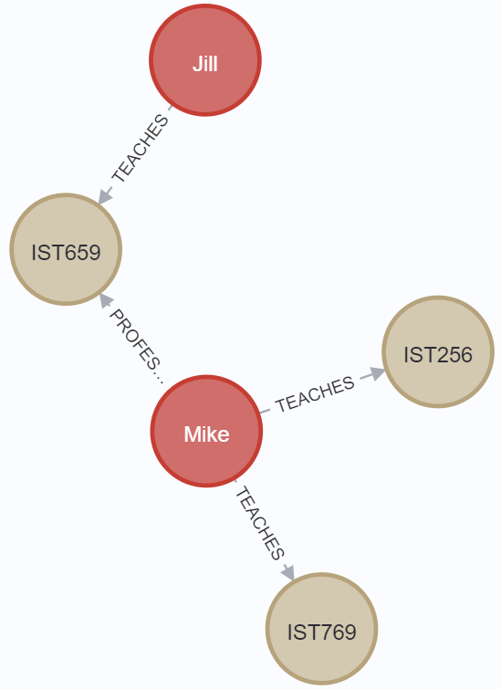
Cypher: Build a Graph CREATE / MERGE
CREATE Adds a node and/or relationship. It will re-add the same data.
MERGE Will not a add the same data. (UPSERT)
merge (f1:Faculty {name:'Mike'})- [t1:TEACHES {semester:'fall2021'}]-> (c1:Course {code:'IST769'})
merge (f1)-[t2:TEACHES {semester:'fall2021'}]-> (c2:Course {code:'IST256'})
merge (f1)-[p1:PROFESSOR_OF_RECORD]-> (c3:Course {code:'IST659'})
merge (f2:Faculty {name:'Jill'})- [t3:TEACHES {semester:'fall2021'}]->(c3)

Slide 185
Cypher : MATCH
Match is used to query data.
Here is the SELECT * Equivalent
match (f:Faculty)- [t:TEACHES]-> (c:Course)
return f,t,c

Slide 186
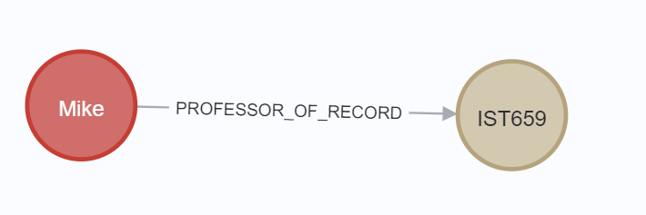
Cypher: MATCH with WHERE
Who is the professor of record for IST659?
match (f:Faculty)- [p:PROFESSOR_OF_RECORD]->(c:Course)
where c.code ='IST659'
return f,p,c

Slide 187
Graph Data Modeling
https://neo4j.com/developer/data-modeling/

Slide 188
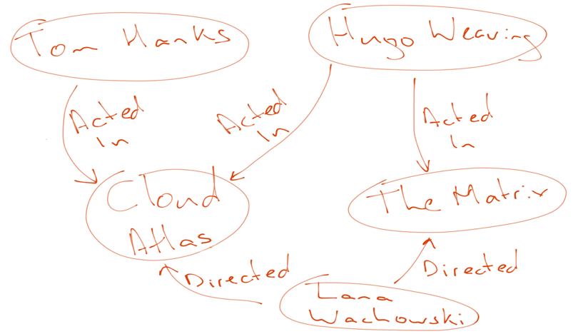
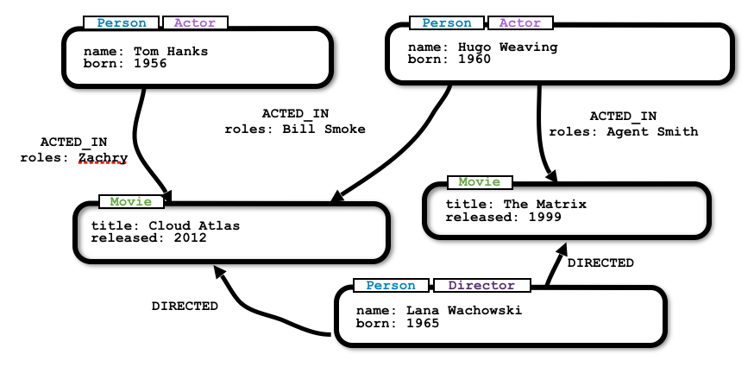
"Whiteboard Friendly"

Slide 189
Graph Data Modeling
Conceptual E-R Modeling works
Entities Become Nodes Labeled to match the Entity
Relationships become Relationships of course
Cardinality doesn't matter
Resolve Multi-valued attributes to Relationships
Lots of relationships are fine. This is what graph is for!
When in doubt:
more nodes and relationships with fewer attributes
Instead of fewer nodes / relationships with more attributes
Think: Exact opposite of the Document Model!!!

Slide 190
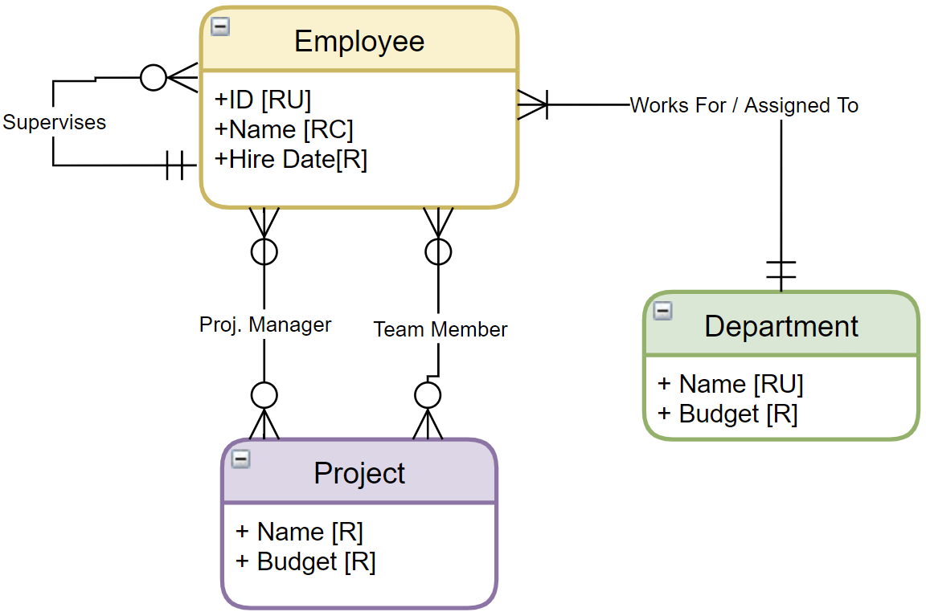
Challenge: Graph model This!
Nodes?
Relationships?
Properties?
White Board it with real data!

Slide 191
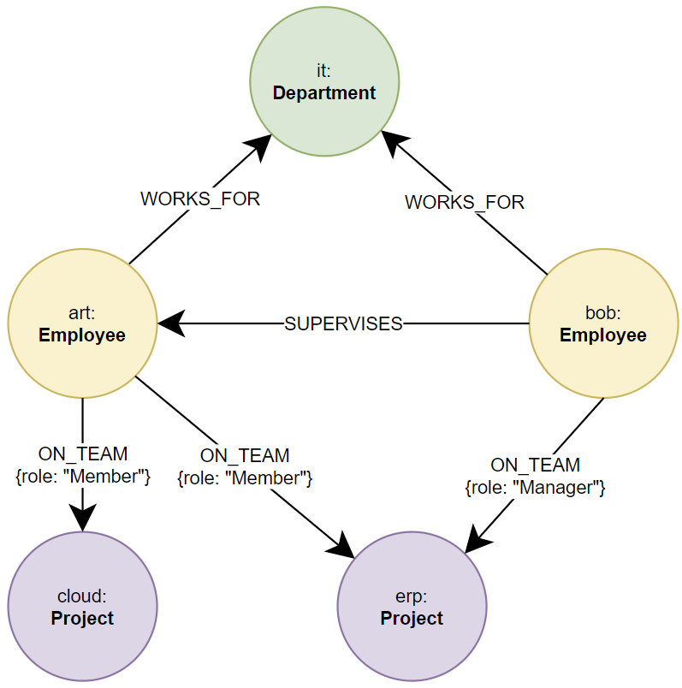
A Graph Solution

Slide 192
Graph Data Science Library
https://neo4j.com/product/graph-data-science-library/

Slide 193
Algorithms
Community Detection – find significant interactions (relationships) among nodes.
Centrality (Importance) – Find influential nodes (PageRank)
Similarity – Discover similar nodes based on relationships / properties
Heuristic Link Prediction – predict the likelihood of a new relationship being formed.
Pathfinding – find shortest, or most efficient paths between nodes.
Node Embedding – Convert node relationships to vectors for ML tasks

Slide 194
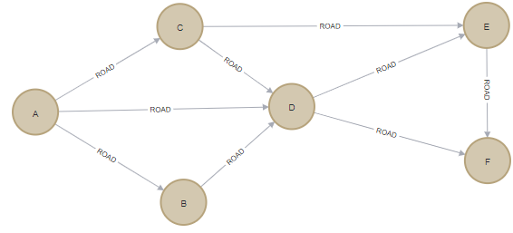
Example: Shortest Path
CREATE (a:Location {name: 'A'}), (b:Location {name: 'B'}), (c:Location {name: 'C'}), (d:Location {name: 'D'}), (e:Location {name: 'E'}), (f:Location {name: 'F'}), (a)-[:ROAD {cost: 50}]->(b), (a)-[:ROAD {cost: 50}]->(c), (a)-[:ROAD {cost: 100}]->(d), (b)-[:ROAD {cost: 40}]->(d), (c)-[:ROAD {cost: 40}]->(d), (c)-[:ROAD {cost: 80}]->(e), (d)-[:ROAD {cost: 30}]->(e), (d)-[:ROAD {cost: 80}]->(f), (e)-[:ROAD {cost: 40}]->(f);
CALL gds.graph.create( 'myGraph', 'Location', 'ROAD', { relationshipProperties: 'cost'
})

Slide 195
Example: The Algorithm Call on 'myGraph'
MATCH (source:Location {name: 'A'}), (target:Location {name: 'F'})
CALL gds.shortestPath.dijkstra.stream('myGraph', {
sourceNode: source, targetNode: target, relationshipWeightProperty: 'cost'
})
YIELD index, sourceNode, targetNode, totalCost, nodeIds, costs, path
RETURN
index,
gds.util.asNode(sourceNode).name AS sourceNodeName,
gds.util.asNode(targetNode).name AS targetNodeName,
totalCost,
[nodeId IN nodeIds | gds.util.asNode(nodeId).name] AS nodeNames,
costs, nodes(path) as path
ORDER BY index

Slide 196
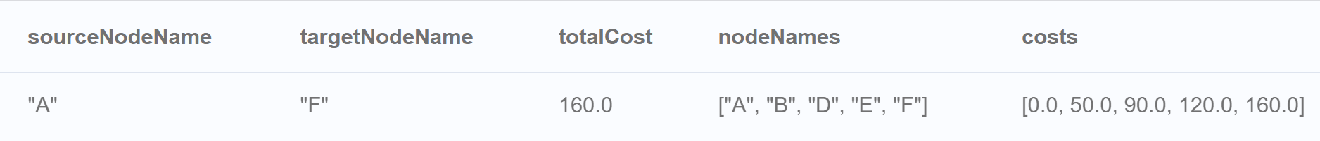
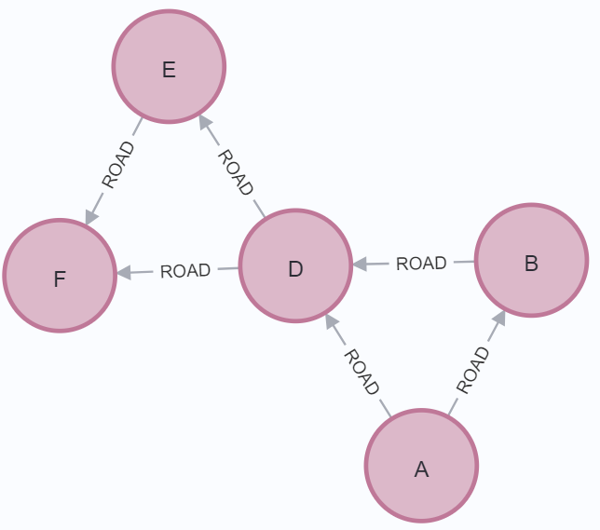
Example: Results
80
100

Slide 197
Summary
Don’t consider big data unless your data needs to be distributed
Hadoop was foundational in Big Data but is difficult to manage
Its easy to start with Spark and scale out as your needs grow, and use the cloud.
NoSQL is more about special-purpose data models at scale than replacing relational DB’s.
We looked at 3 different models: Document, Big Table, and Graph discussing designs and use cases.

Slide 198
Applications of Opensource in Big Data Management with Examples
Michael Fudge
Professor of Practice
Syracuse University
CASL Workshop, December 2022
https://github.com/mafudge/cas-library-bigdata-workshop-2022
Notes:
This course is very much a tour of the modern database landscape. Before we begin that tour, its helpful to understand how we got here and why.

